Slide 1
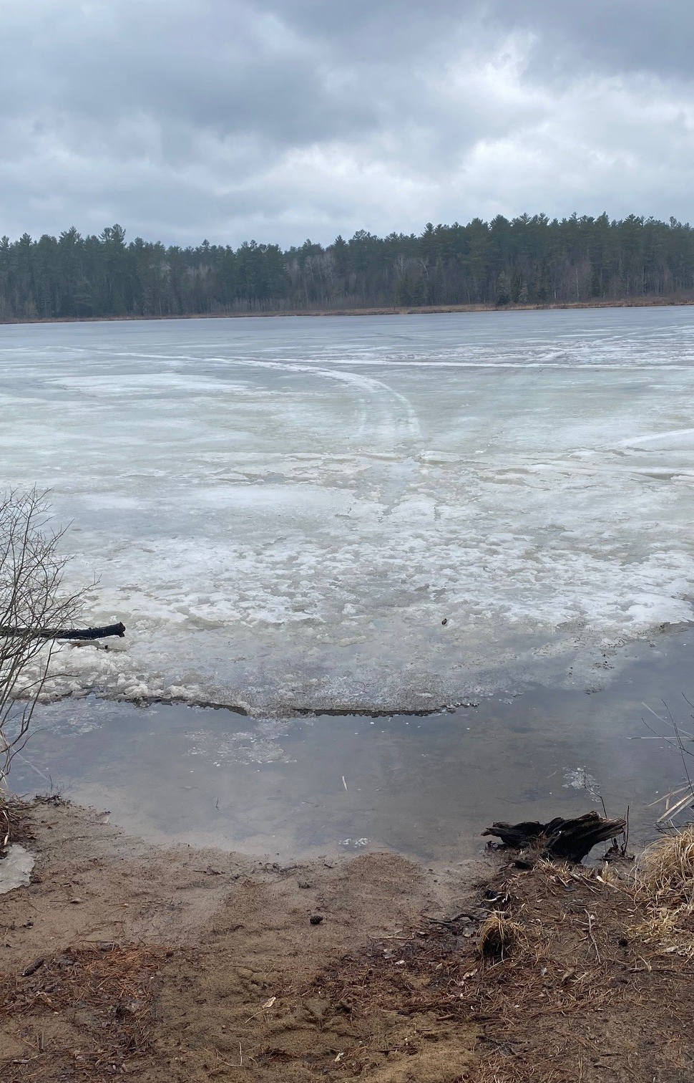
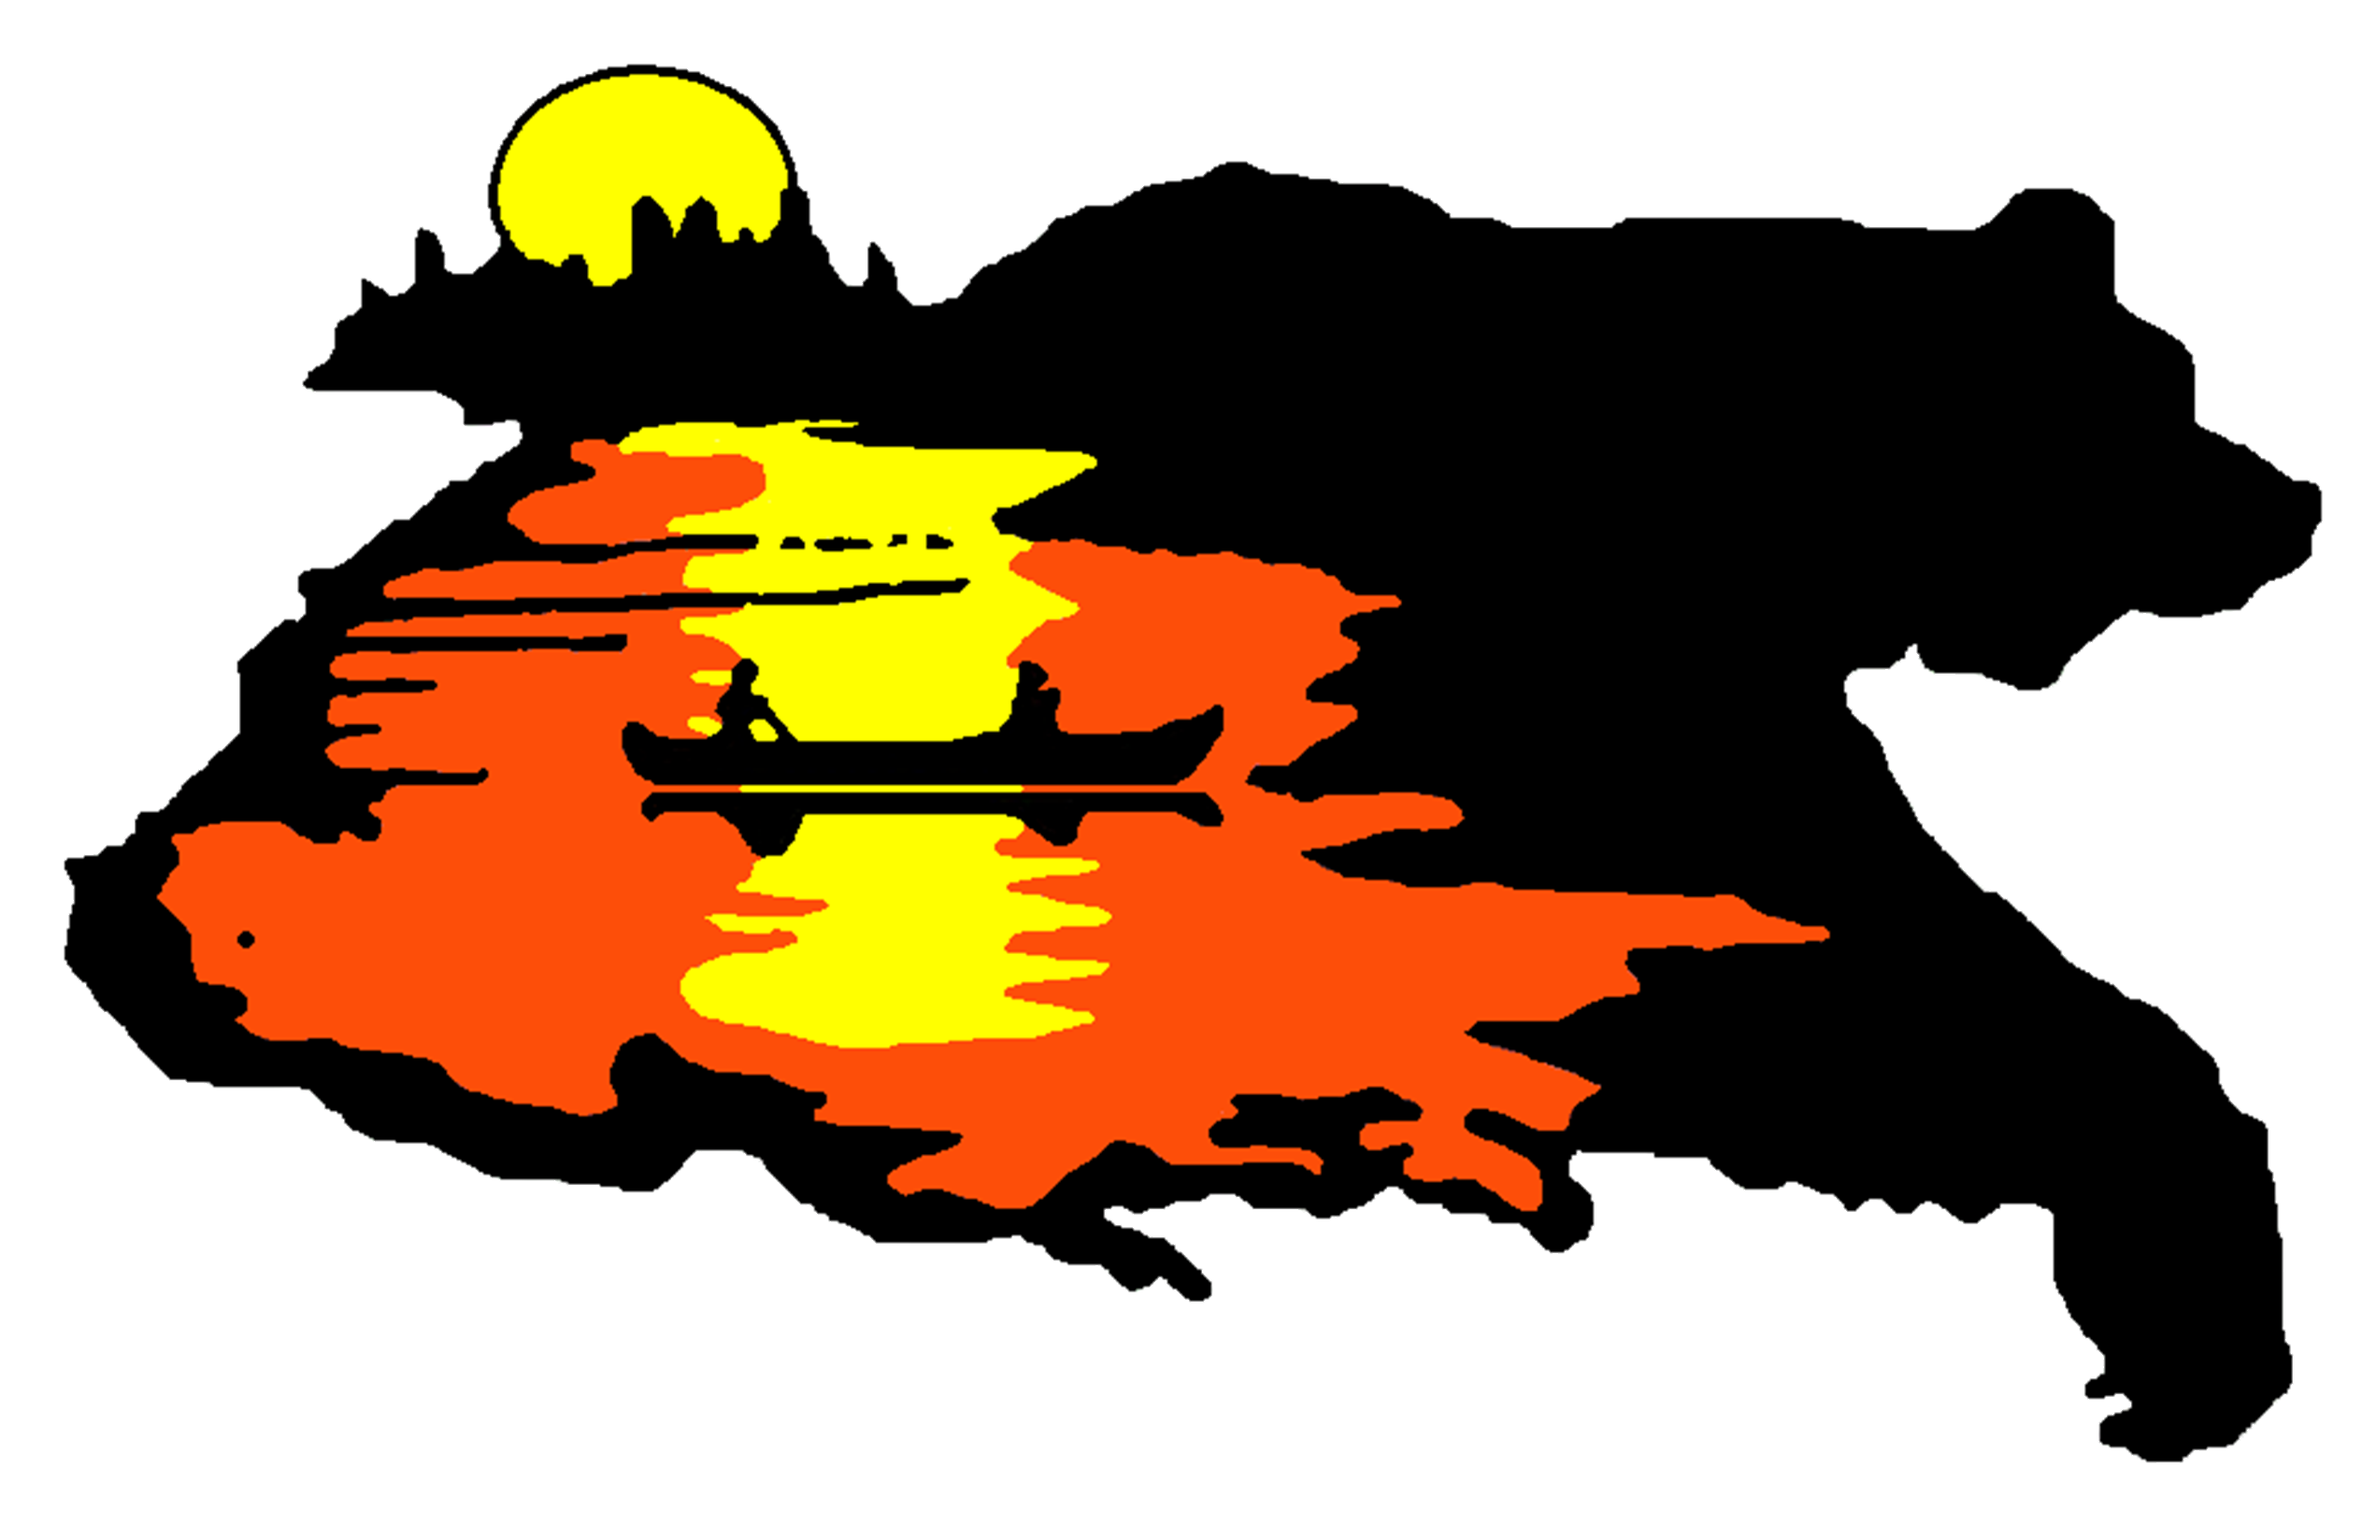
The Algonquins of Greater Golden Lake First Nation
Sand Lake
Species at Risk
Presentation
Research / Monitoring / Analysis / Statistics

Slide 2
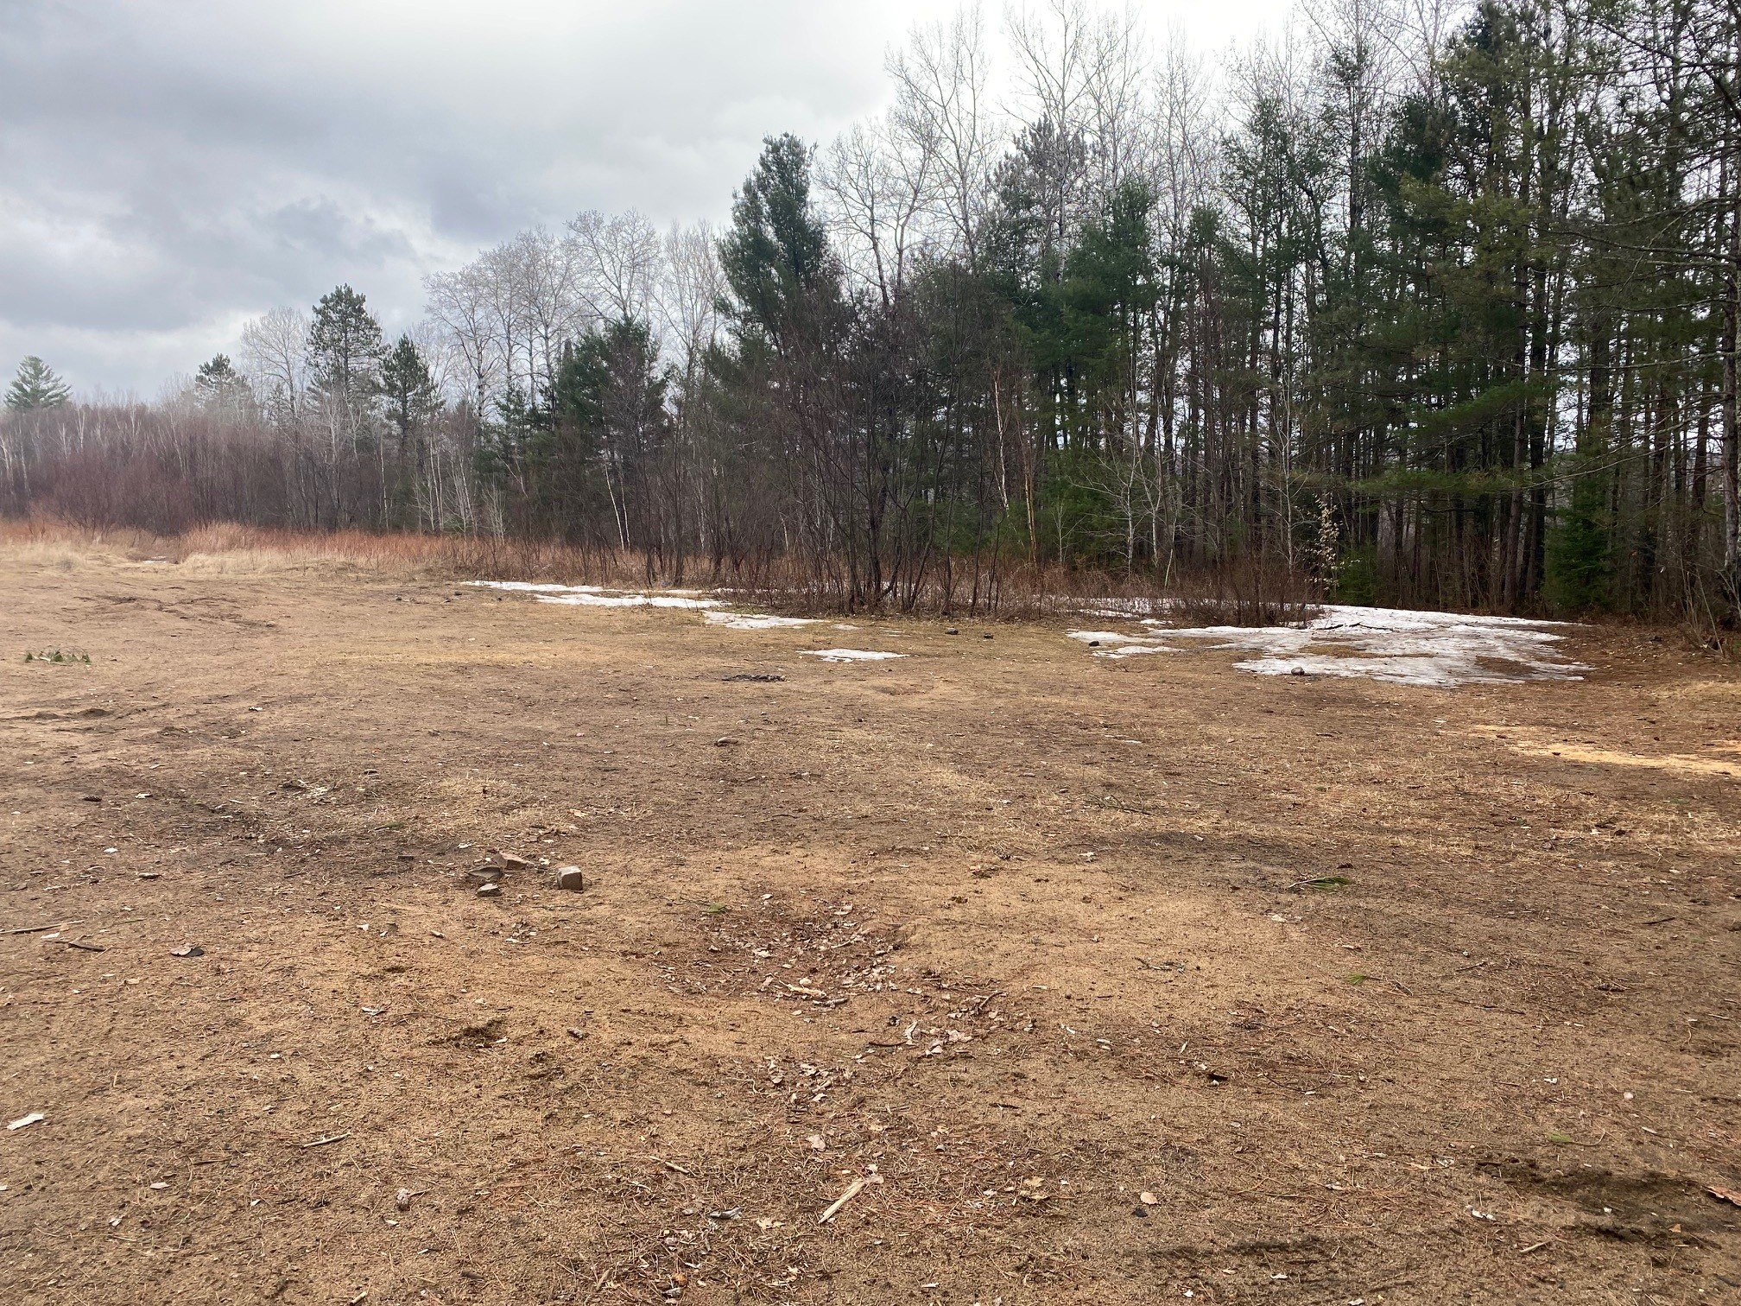
Sand Lake(Rec 372)
Is one of many sole land selections that will be transferred to the Algonquins of Greater Golden Lake First Nation upon completion of the Treaty.
Approximately 40 acres of land with easy access to Sand Lake
Located at Km 9 just off Baron Canyon Road – Before The Sand Lake Gate-GPS:45°48'59.9"N 77°27'47.0"W
This is home to many different Species at Risk
Surrounded by a variety of forest, woodland and thicket
Future intensions of building an Algonquin Cultural Centre

Slide 3
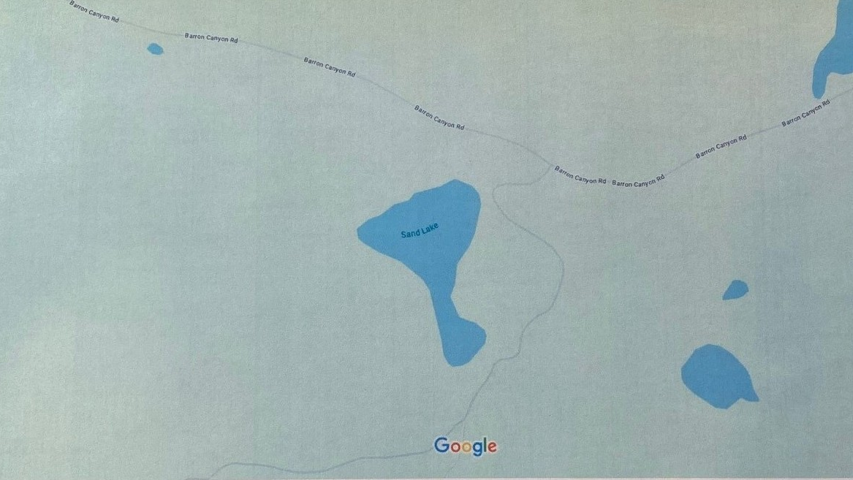

Slide 4
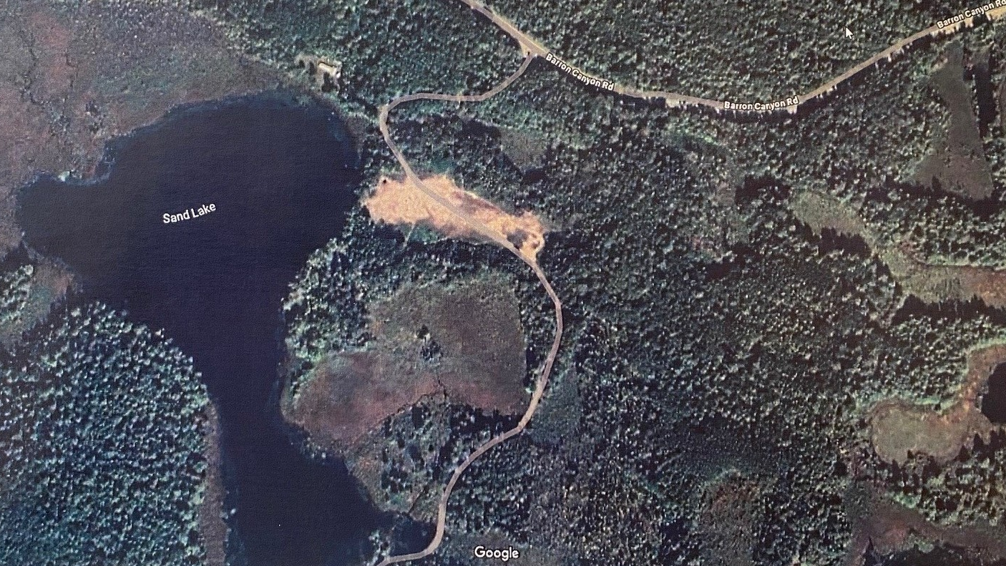

Slide 5
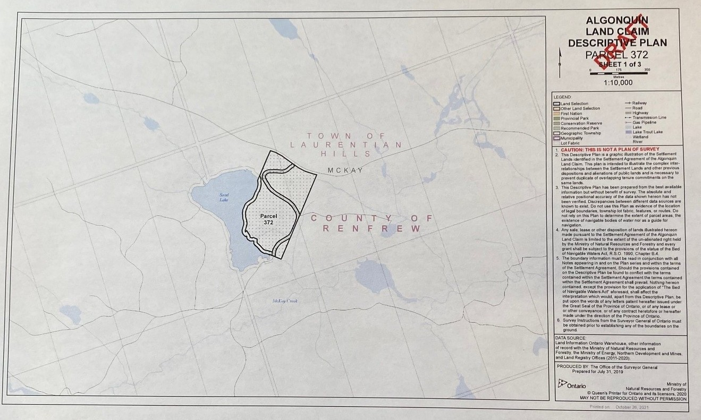

Slide 6
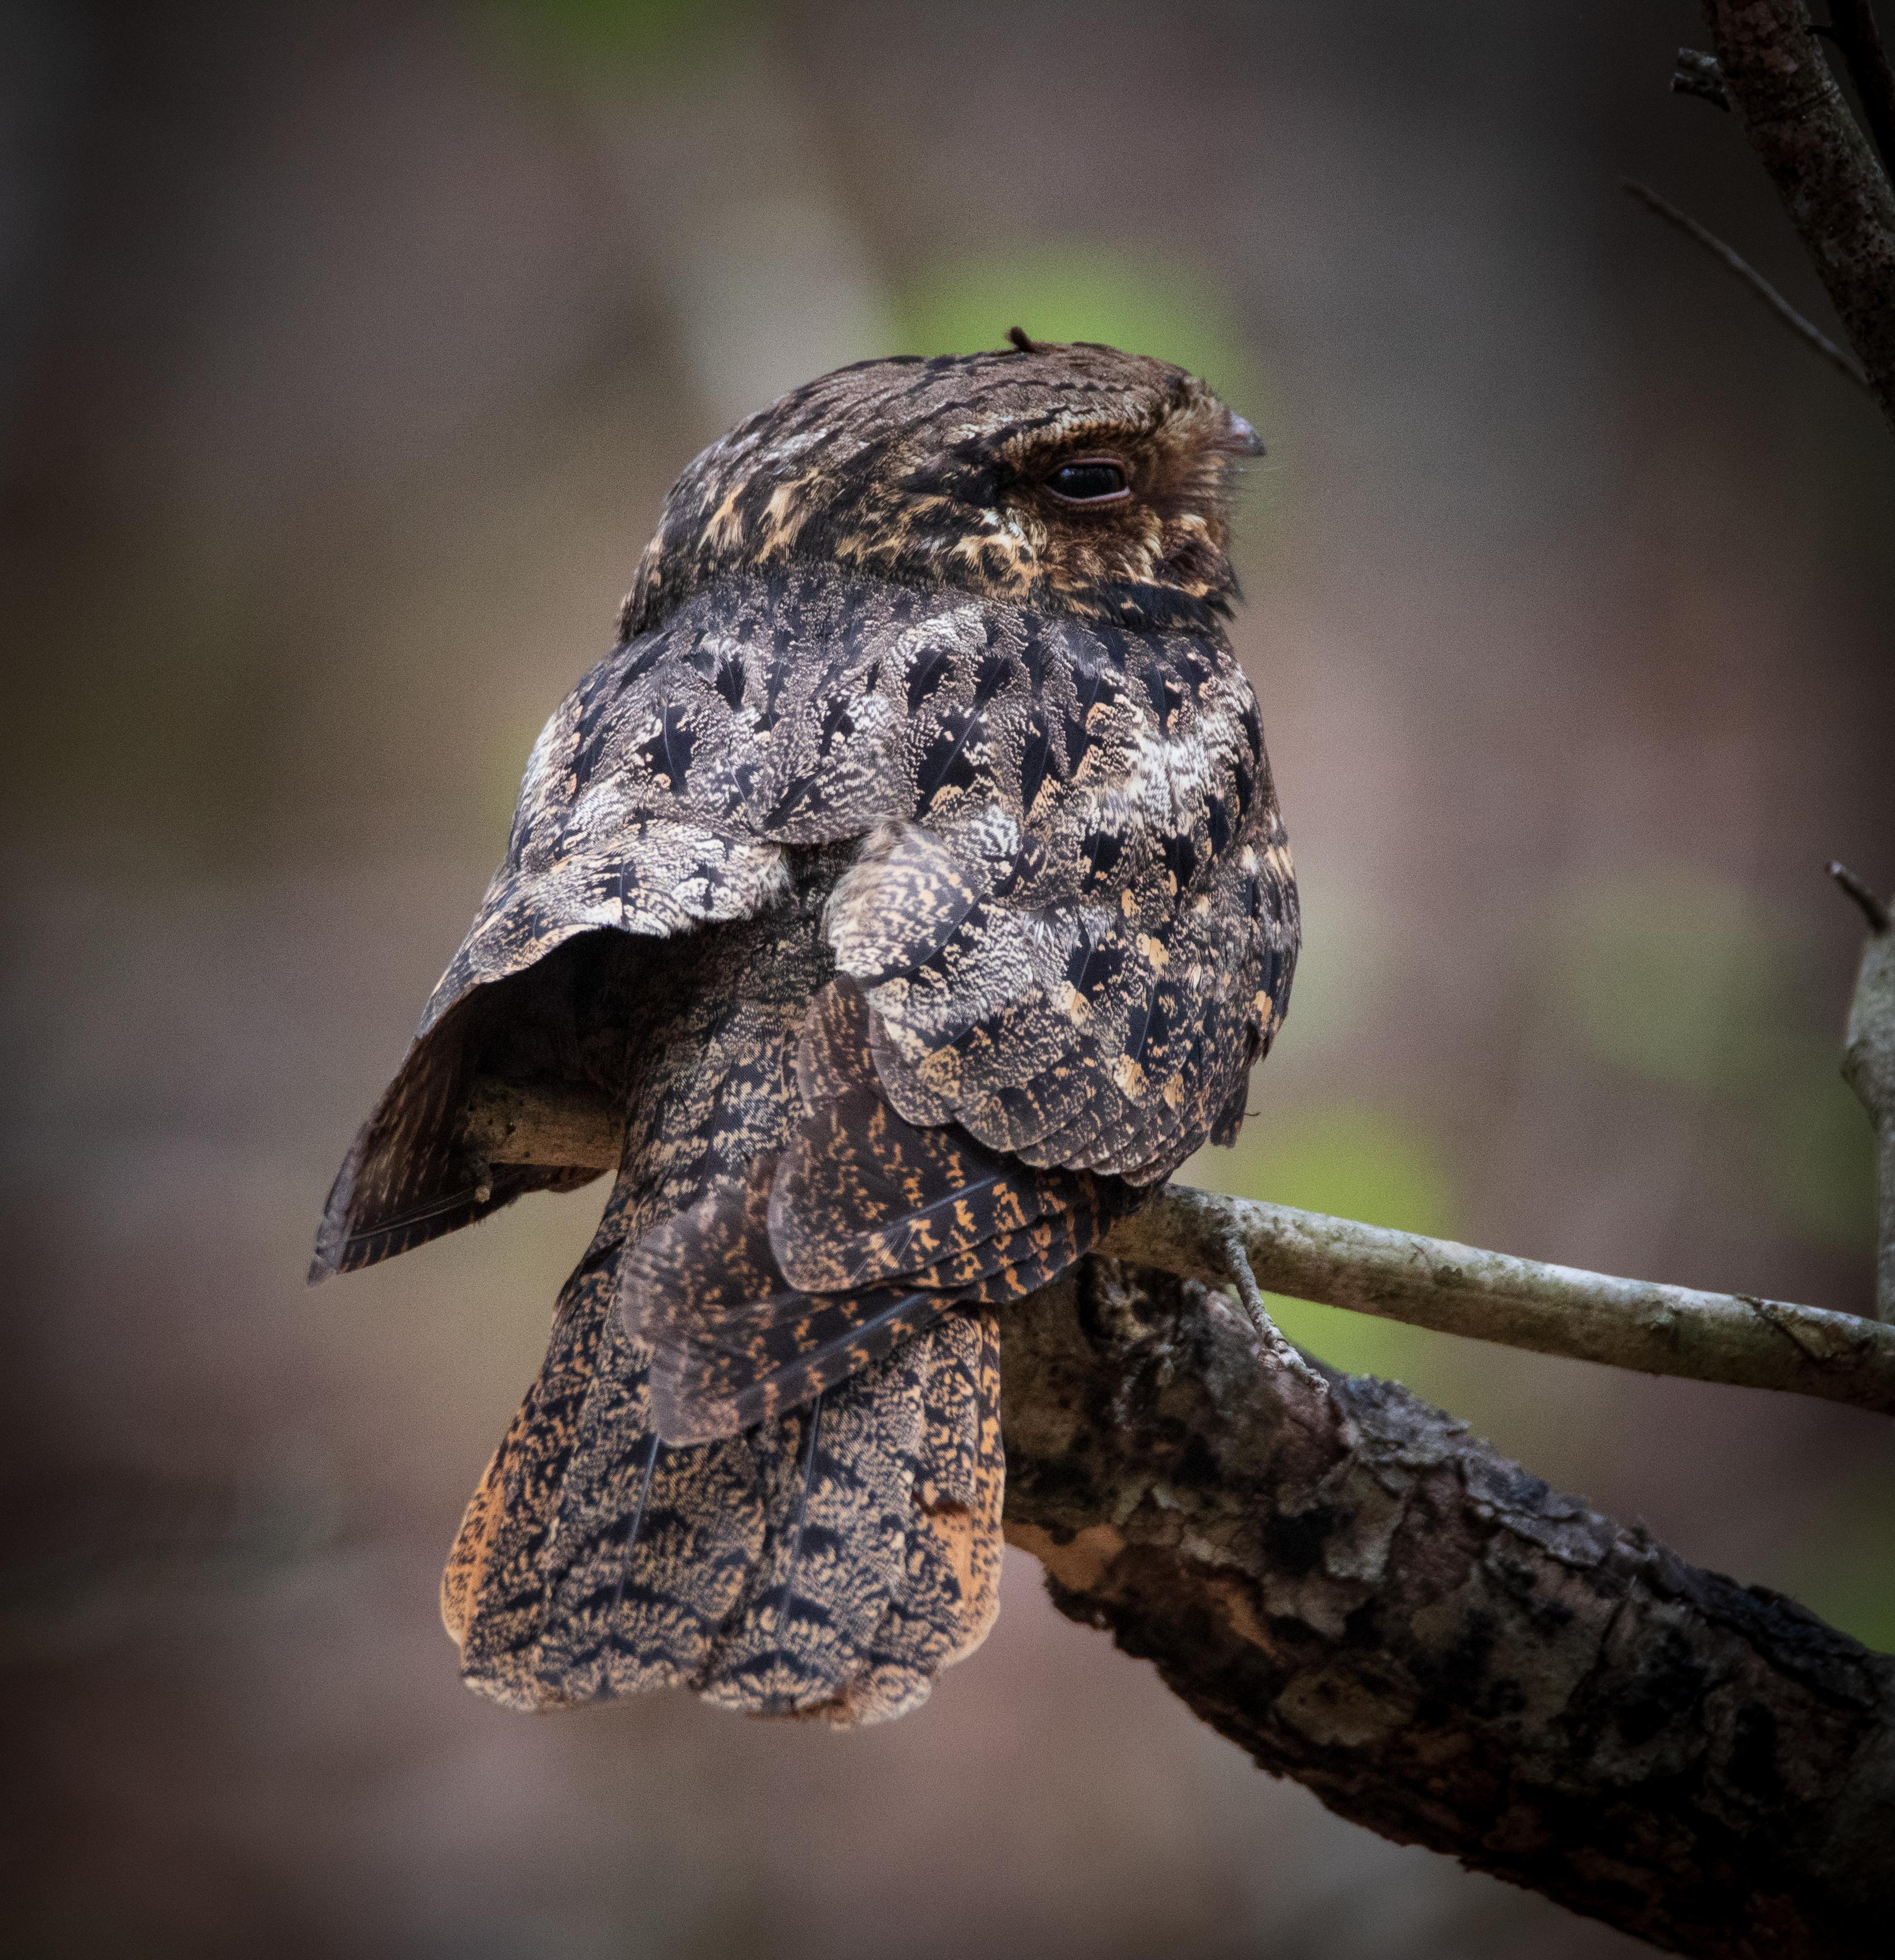
SPECIES AT RISK
Eastern Whip-poor-will
How to describe the Eastern Whip-poor-will’s appearance?
The Eastern Whip-poor-will is a medium-sized bird 22 to 26 centimetres long with mottled brown and grey feathers that help it blend in with its surroundings.
The Whip-poor-will has a flat head, large, well adapted eyes for seeing at night when they are active and are looking for food. They have a small beak with long feathers or whiskers around it; which helps for sensing flying insects.
Since it becomes active at dusk and rests during the day, it is more commonly heard than seen.
The Eastern Whip-poor-wills are most vocal during bright, moonlit nights when they can be heard singing their name "Whip-poor-will" often in long, seemingly endless series up to 400 times without stopping. Whip-poor-wills are in the same scientific family as the Night Jars and Nighthawks. They are also related to the Owls.

Slide 7
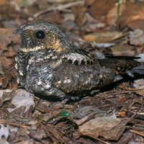
WHERE AND WHAT?
Where to find the Eastern Whip-poor-will?
Eastern Whip-poor-will is usually found in areas with a mix of open and forested areas. Such as open woodlands or openings in more mature, deciduous, coniferous and mixed forests.
It forages in these open areas and uses forested areas for roosting (resting and sleeping) and nesting.
It lays its eggs directly on the forest floor, where its colouring means it will easily remain undetected by visual predators.
What do they consume to survive?
Whip-poor-wills forage only at dawn or dusk but can forage all night during moonlit nights.
The Whip-poor-will feed in mid-air on large flying insects like moths and scarab beetles, but also consumes other insects such as beetles, grasshoppers, stoneflies and weevils.

Slide 8
PARTNERS
Where do they lay their eggs?
Whip-poor-will nests and the immediate area around the nest (i.e., 20 m) are highly sensitive features supporting the species’ reproduction life cycle and have the lowest tolerance to alteration. These are areas the species depends on for egg laying, incubation, feeding, resting and rearing of young.
Whip-poor-wills do not construct a traditional nest as eggs are laid directly on leaf litter. Nests require tree cover, shade, sparse ground cover, and proximity to open areas for foraging on flying insects.
Suitable breeding habitats generally include open and half treed areas and often exhibit a scattered distribution of treed and open space. Structure is known to be an important factor in habitat selection. Perching and roosting sites are important features found within this area. During the day, adults will lay motionless on a roost site (or nest) and become active only at dusk.
When is their mating season?
In Ontario, the Eastern Whip-poor-will’s breeding season, which is also it’s mating season, typically lasts from late May to mid-August. They arrive in the breeding grounds by mid-May. They are most active during the period leading up to the full moon in June. Whip-poor-wills breed in deciduous or mixed forests with little or no underbrush.
Do they have only one life-long partner?
The Eastern Whip-poor-wills are considered socially monogamous. Meaning they form strong pairing bonds for a breeding season, but they may not mate for life. And on the other hand, it has been observed that some pairs do breed together for several consecutive years.
Whip-poor-wills that range greater than 500 m from nesting sites are likely females that have abandoned the territory due to loss of a mate.

Slide 9
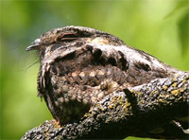
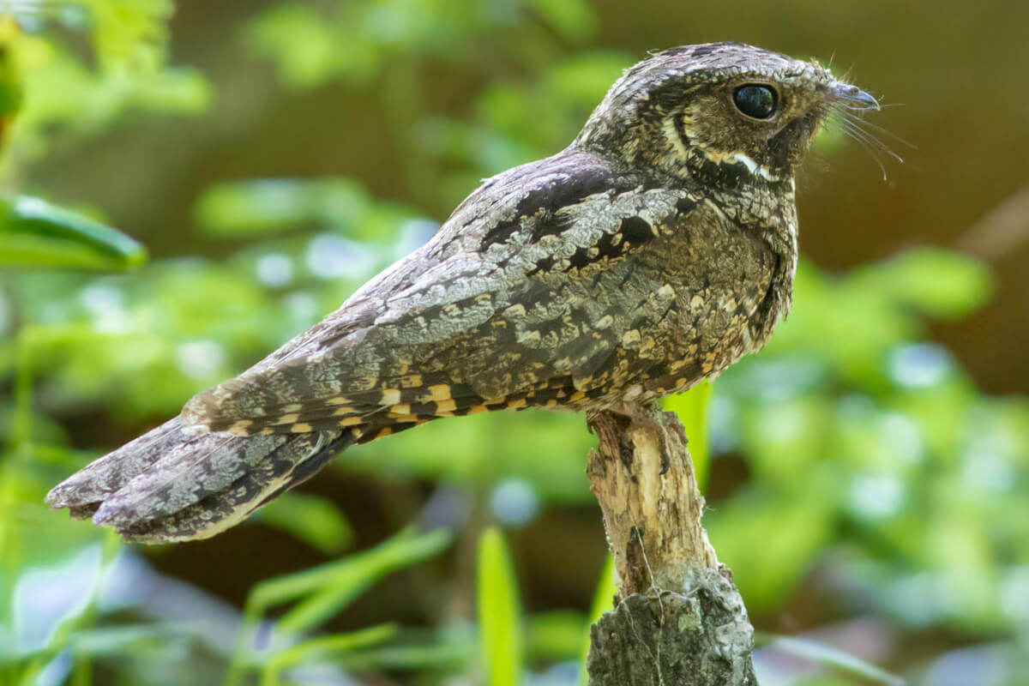
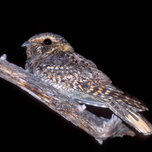

Slide 10
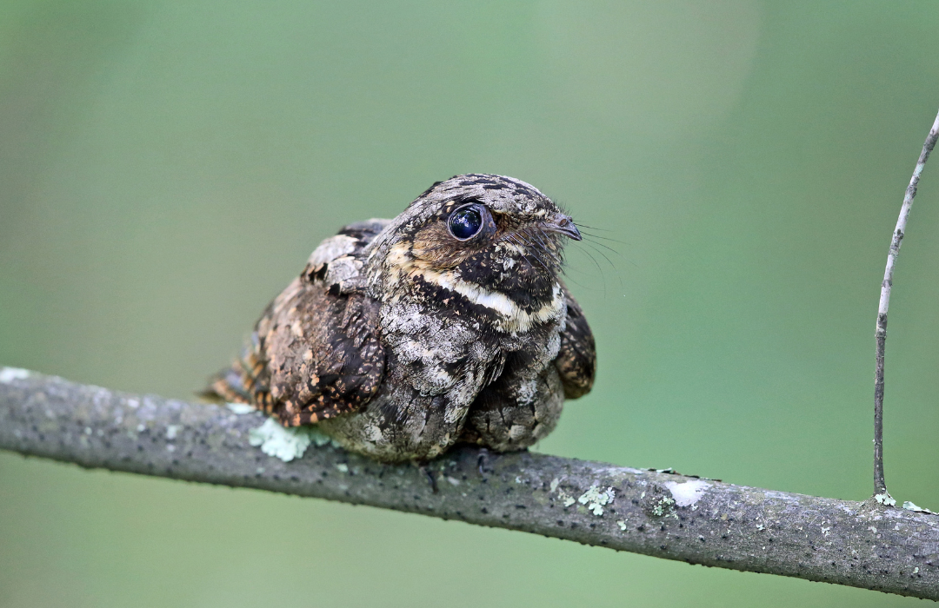
When do the eggs hatch?
The whip-poor-will lays its eggs in phase with the lunar cycle, so that the eggs hatch on average 10 days before a full moon. When the moon is near full in June the adults can forage the entire night and provide the nestlings with insects.
Pairs usually raise two chicks, with the eggs laid on leaves on the forest floor. Chicks begin to move about quickly and leave their birth site shortly after hatching.
When and where does the Eastern Whip-poor-will hibernate?
The Whip-poor-will generally leaves Ontario between early September and late November. They migrate to Mexico and Central America, from South Carolina and along the Gulf of Mexico to Guatemala where they stay throughout the cold Canadian winters. They return to Ontario for breeding season between late March and mid May.
Who are their predators?
The Whip-poor-will, their eggs and their young, although well camouflaged on the ground, are eaten by many natural predators such as raccoons, skunks, coyotes, red foxes and snakes.
To discourage predators, adults will fake injuries by flopping around on the ground in full view to lead predators away from the nest.
“This is called The Broken Wing Display”.

Slide 11
CAUSES OF DEATH
What can be done to help the Eastern Whip-poor-will?
Inspire Change: Encourage the reduction or elimination of pesticides and biocides in agriculture and forestry.
You should also avoid using pesticides in your yards.
You should never ever enter the perimeter of their nesting area.
You should discuss this serious matter with your family to create more awareness.
This species is federally protected under the Species at Risk Act and is also protected under the Migratory Birds Convention Act (1994). They also experience protection where they occur in provincial parks and reserves.
The government’s short-term goal for the recovery of the Eastern Whip-poor-will is to slow the population decline by mitigating threats and promoting suitable habitat conditions over the next 10 years. The long-term goal is to support natural increases in the species’ abundance and distribution.
What are the threats facing this species?
With weather patterns becoming more erratic, this may affect the timing of some species’ returning to breeding grounds and making them more susceptible to poor weather conditions on their return. Or their breeding cycles may no longer be timed to coincide with peak insect hatches. Additional threats include car mortalities and changes in food supply related to pesticides.
Why are they labeled as a Species at Risk?
Although there is some uncertainty surrounding the decline of the Eastern Whip-poor-will, the main threat to the species is likely habitat loss and degradation, reduced prey availability and climate change.
Human activities like agriculture expansion, residential development and deforestation have contributed to their habitat loss. Changes to the food supply, including the effects of pesticides also impact this species.

Slide 12
Do you have ANY SUGESTIONS ON WHAT THE AGGLFN COMMUNITY CAN DO TO HELP THE EASTERN Whip-POOR-WILL?
PAUSE FOR RESPONSES OR COMMENTS FROM THE COMMUNITY MEMBERS AND RECORD THEM.

Slide 13
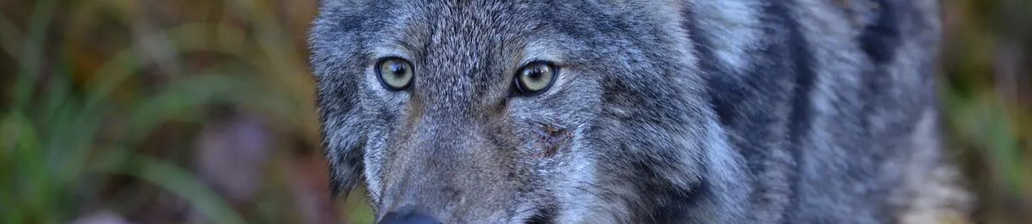
SPECIES AT RISK
THE EASTERN WOLF
How to distinguish if this is an Eastern Wolf?
Eastern wolves in Ontario are medium-sized canids, generally reddish-brown or tawny in color, though their fur can vary.
They are slightly larger than coyotes but smaller than gray wolves, with females averaging 24 kg and males 29 kg.
Their fur can also range from a grizzled grayish-brown colour and mixed cinnamon. The nape, shoulders and tail regions are a mix of black and gray, with the flanks and chest being rufous or a creamy colour.
They have thick fur, lankier legs, and a narrower chest compared to a German Shepherd.

Slide 14
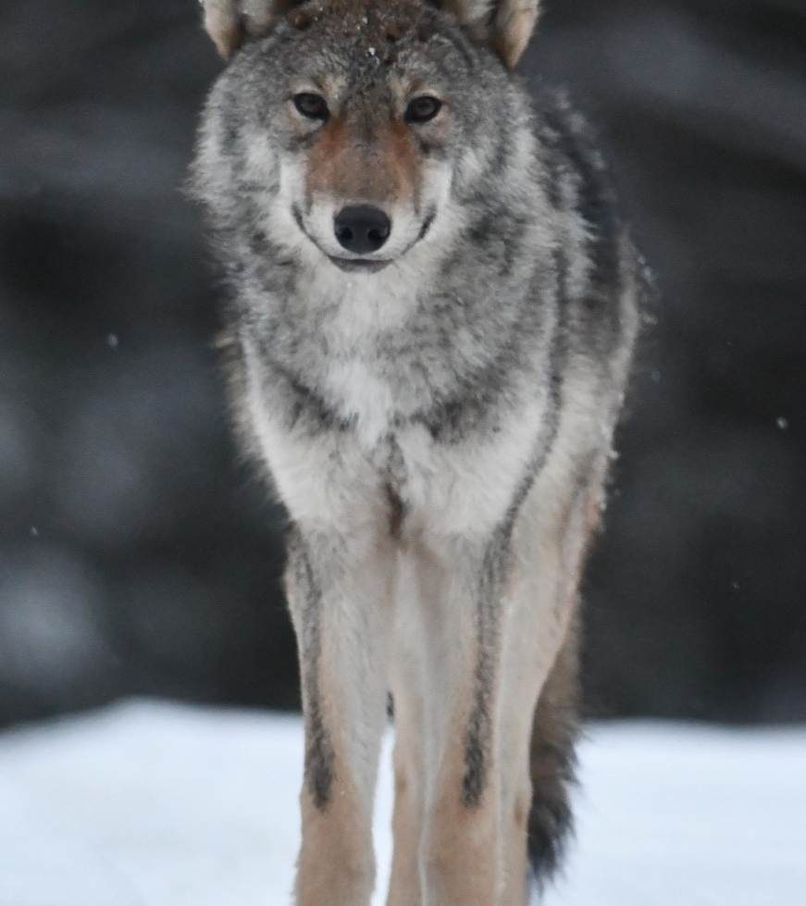
What do they consume to survive?
Diet: The Eastern Wolf mainly preys on ungulates (Hoofed Mammals) like moose, caribou, elk, and deer, but their primary source is white-tailed deer. They will also prey on smaller mammals like beavers. They hunt larger prey in packs and smaller prey individually.
Where do they live?
The Eastern Wolf is typically found in deciduous and mixed forest landscapes. In Ontario, Eastern Wolves are primarily found in Algonquin Provincial Park and surrounding townships, as well as in other areas like Killarney Provincial Park, Kawartha Highlands Signature Site, and Queen Elizabeth II Wildlands. They also inhabit regions around Manitoulin Island and Sault Ste. Marie.
When is their mating season?
In Ontario, the breeding season for Eastern Wolves typically occurs in February and March. The breeding pair, the alpha male and female, will then raise their litter with the help of the rest of the pack.

Slide 15
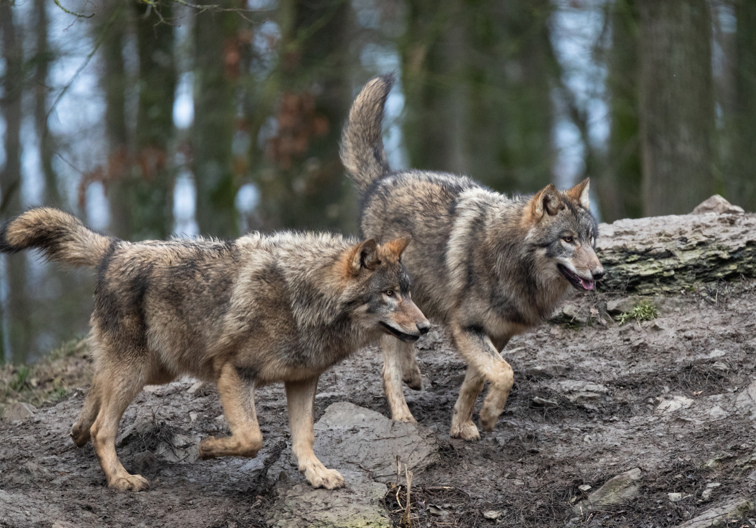
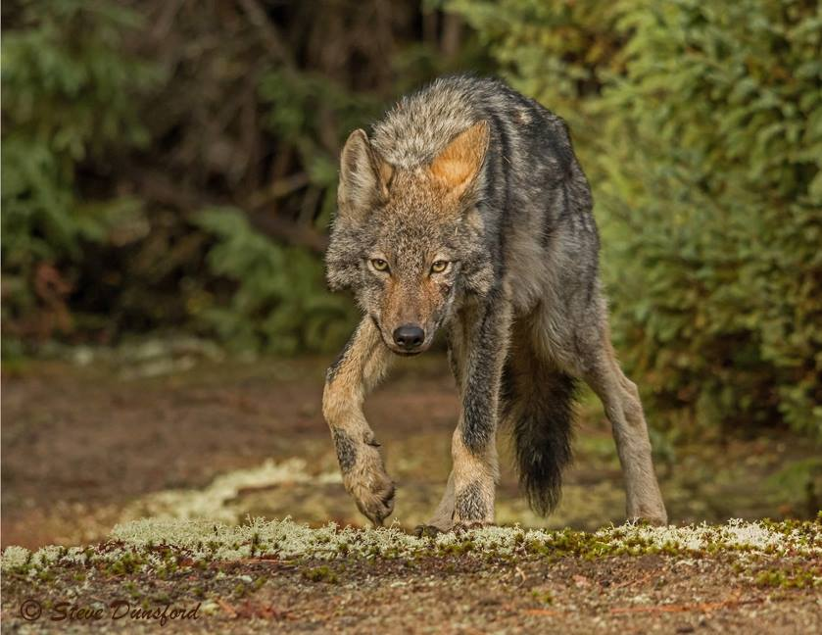
Do they have only one life-long partner?
Yes, Eastern wolves in Ontario, like other wolf species, typically form life-long partnerships with a mate within their pack. These breeding pairs, often the alpha male and female, are responsible for the pack's reproduction and play a key role in maintaining pack stability.
Where is the birthing place located?
Eastern wolves in Ontario give birth in dens located in large forests, typically near wetlands, water sources, conifers, and steep slopes, and away from roads. Pups are nursed in the den for 6-8 weeks, with the whole pack helping to feed and raise them, according to Ontario Wildlife Rescue.

Slide 16
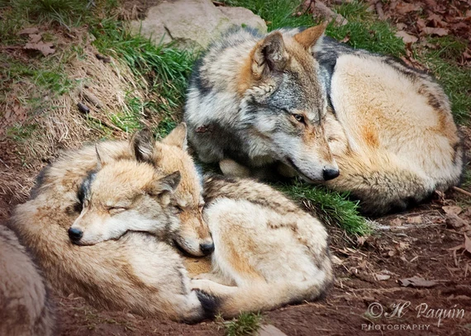
When are the pups born and roughly how many?
Eastern wolves in Ontario typically give birth to their pups in late April or early May. The main breeding pair in a pack will give birth to an average of 4-6 pups, according to Ontario Wildlife Rescue. These pups remain in the den for 6-8 weeks, says the Species at Risk Public Registry.
Does the Eastern Wolf hibernate?
No, eastern wolves in Ontario do not hibernate. They are known to be active in winter, and you can hear them howling or see their tracks. They may seek shelter in dens, especially when a female is giving birth, but they don't undergo a deep sleep like other hibernating animals.
Who are their predators?
Wolves are generally apex predators and don't have many natural predators, while not a direct predator, Eastern Wolves can face competition with coyotes for resources and territory.

Slide 17
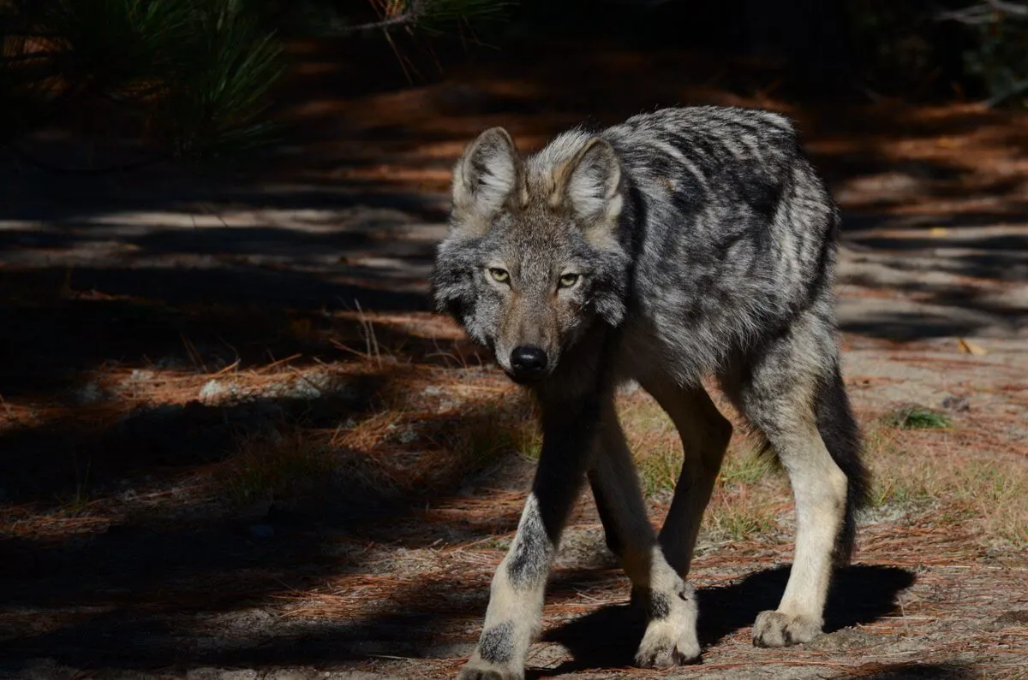
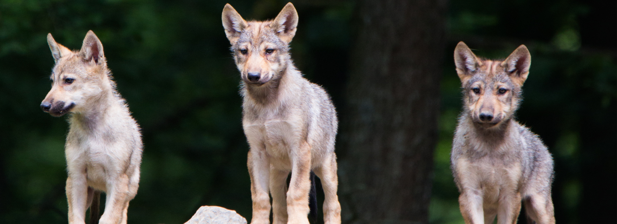
What other ways do most of them die?
In Ontario, the primary threat to Eastern Wolves is not a natural predator, but rather human-caused mortality. Their populations are impacted by human activities outside of protected areas. This includes hunting, trapping, and road-related incidents. Along with continued development and urbanization this can lead to habitat loss and fragmentation, hindering the expansion of the Eastern Wolf population.

Slide 18
Causes of Death
What can be done to help them?
To help Eastern Wolves in Ontario live longer and thrive, a multi-pronged approach is needed.
Including strengthening legal protections such as; banning hunting and trapping to prevent accidental or intentional killings. Deter poaching and illegal hunting.
Expand protected areas and create buffer zones around them to reduce human activity and provide safer habitats.
Improve habitat management, so that wolves can move between different areas to maintain genetic diversity and prevent interbreeding. And maintain a healthy population of prey species for their food security.
Educate the public about the ecological role of wolves and debunk myths about their threats to livestock.
Protecting their habitat and ensuring genetic diversity are also crucial for long-term survival.
Why are they considered a Species at Risk?
Hunting and trapping, particularly outside protected areas, significantly reduces the Eastern Wolf’s population. Road networks also contribute to increased mortality, as they facilitate human access and can lead to vehicle collisions.
Development and the construction of roads lead to the loss and fragmentation of habitat, limiting the wolf's ability to move and find suitable breeding grounds.
Due to the limited availability of Eastern Wolf mates caused by mortality and fragmentation can lead to interbreeding with Eastern Coyotes, which can dilute the Eastern Wolf's genetic integrity and potentially lead to the loss of distinct wolf traits.

Slide 19
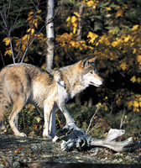
Do you have ANY SUGESTIONS ON WHAT THE AGGLFN COMMUNITY CAN DO TO HELP THE EASTERN WOLF?
PAUSE FOR RESPONSES OR COMMENTS FROM THE COMMUNITY MEMBERS AND REORD THEM.

Slide 20
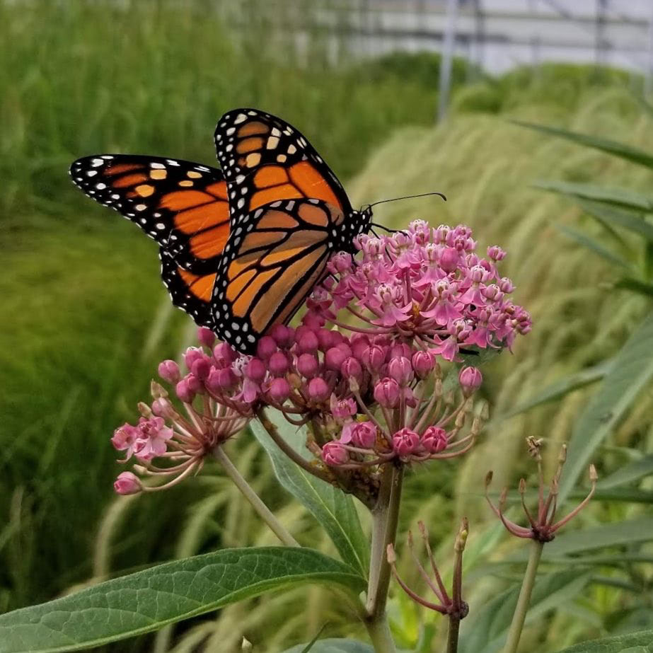
SPECIES AT RISK
MONARCH BUTTERFLY

Slide 21
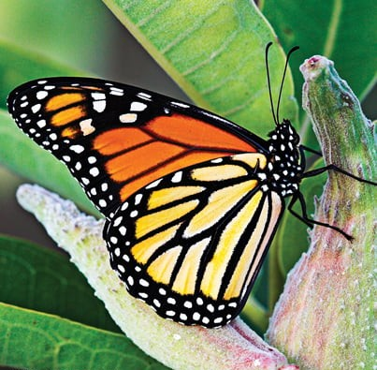
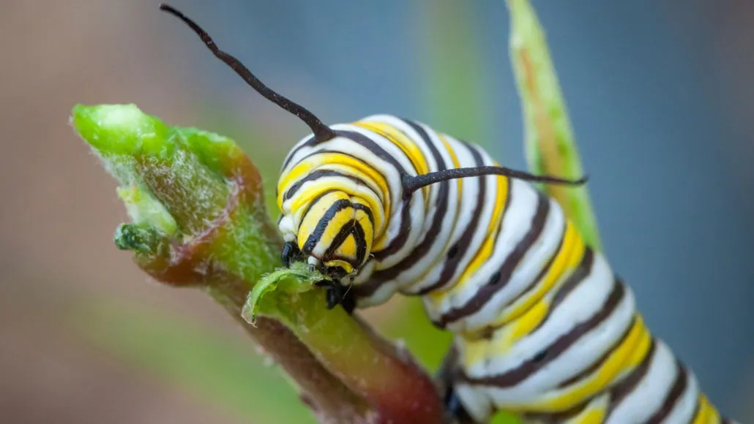
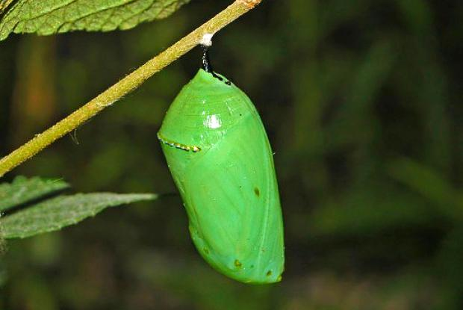
What makes the Monarch Butterfly unique?
Monarch butterfly is easily recognizable due to its vibrant orange, yellow and black wings with small white spots on the borders. They are relatively large, with a wingspan of about 9-10 cm. The Monarch caterpillar is also distinct, displaying black, white, and yellow stripes, and can be found feeding on milkweed plants. The chrysalis stage is a striking jade-green color with golden spots.
What do they consume?
In Ontario, Monarch butterflies lay their eggs on milkweed, which is the sole food source for caterpillars. Adult butterflies depend on native wildflowers for nectar, so by adding these to your gardens you can provide them with a food source too.
Where do they live?
In Canada, Monarchs are most abundant in southern Ontario and Quebec where milkweed plants and breeding habitats are widespread.

Slide 22
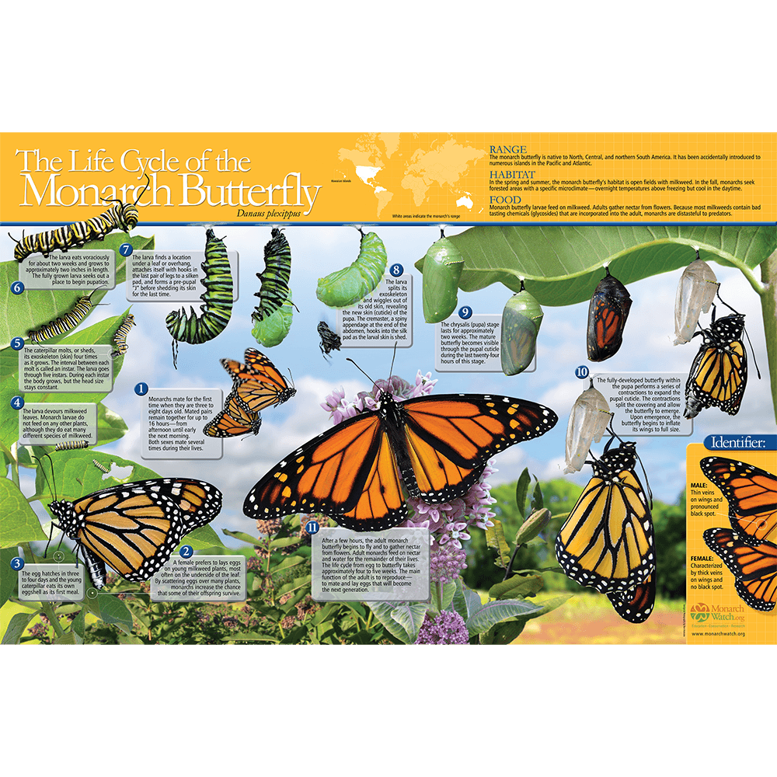

Slide 23
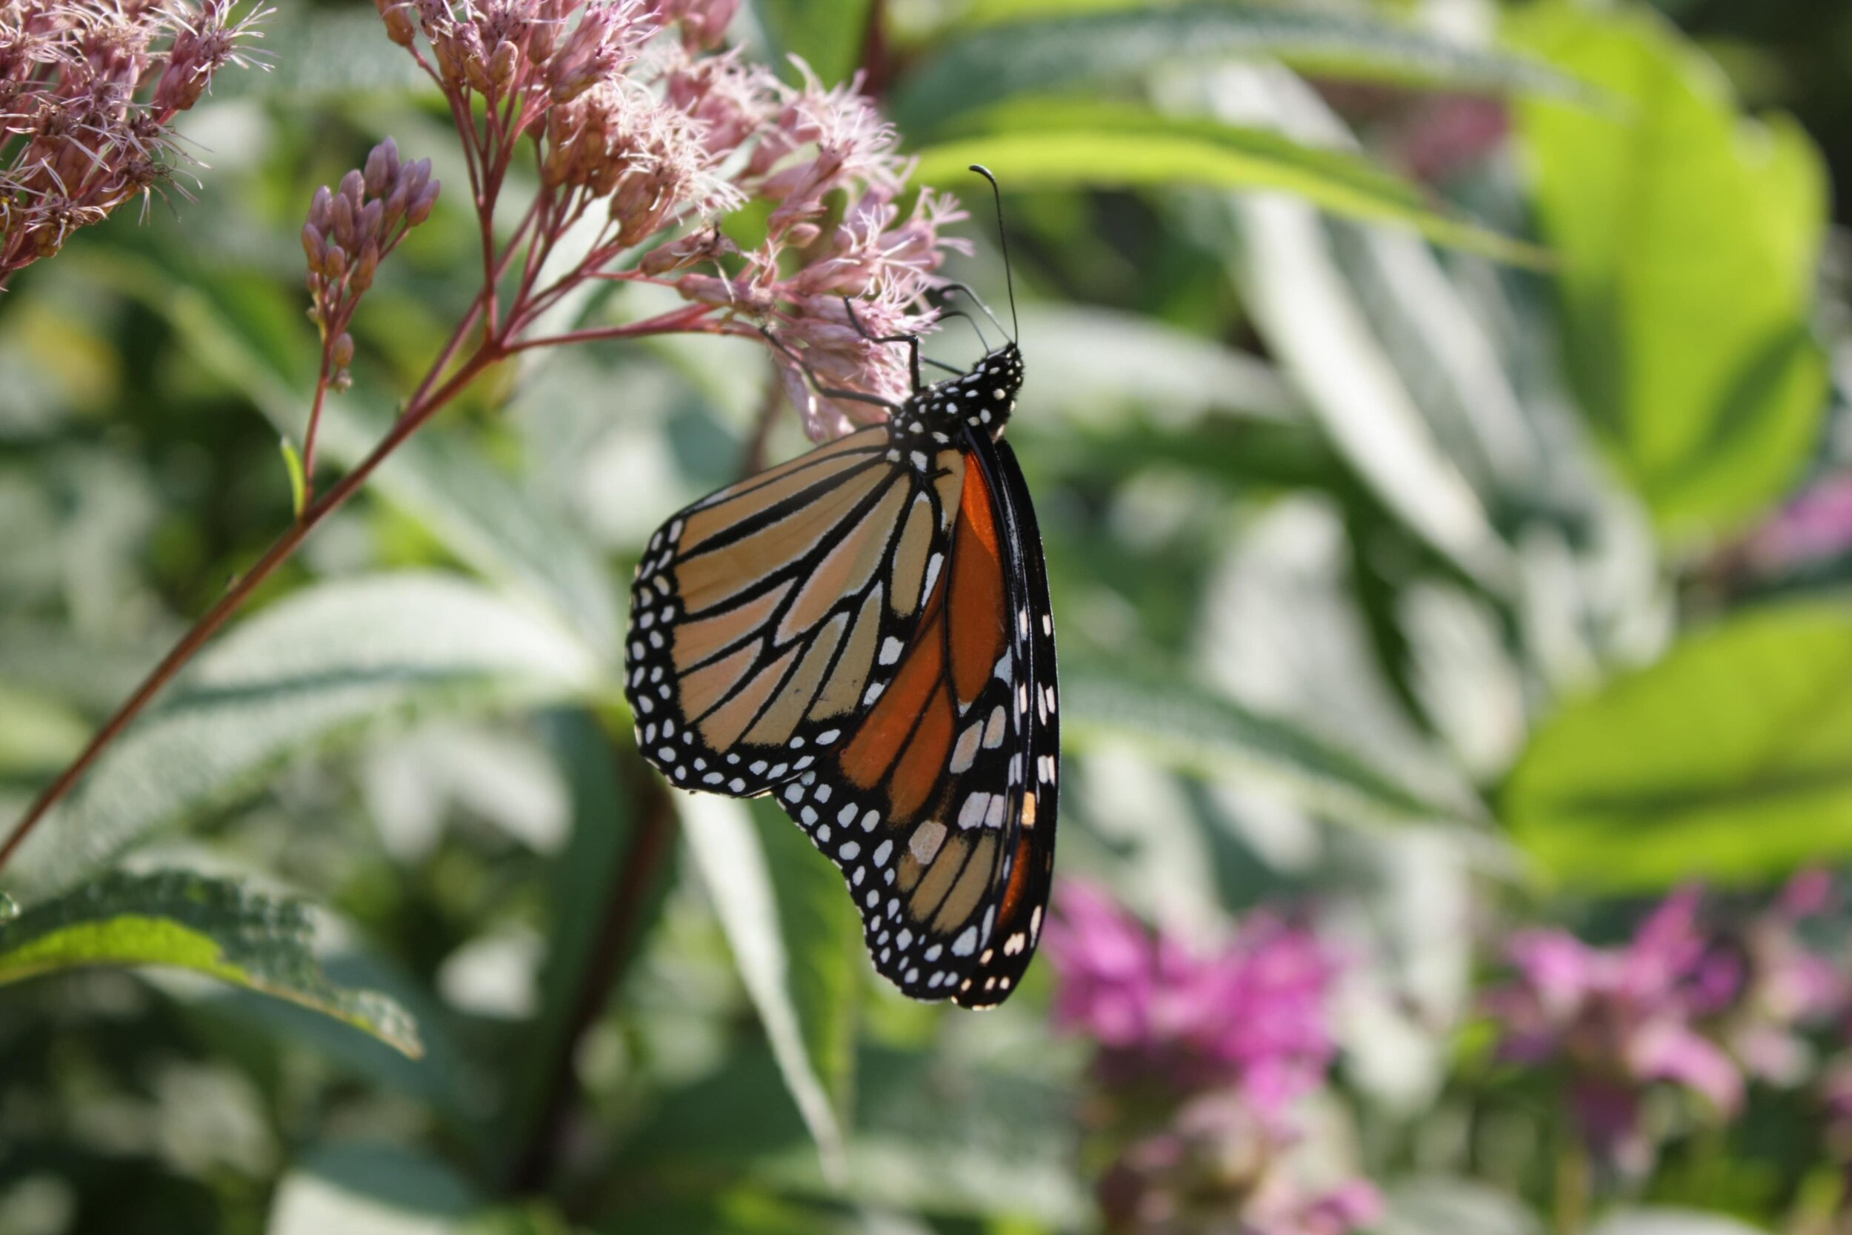
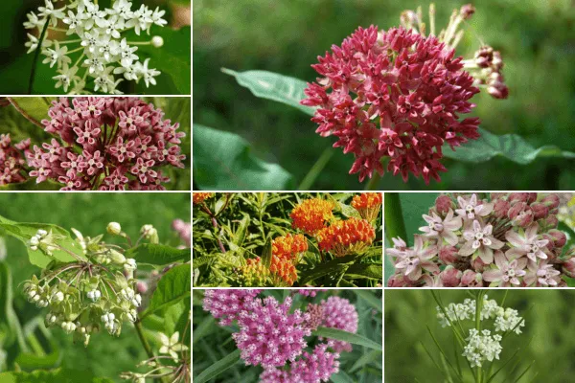
COLOURS OF MILKWEED

Slide 24
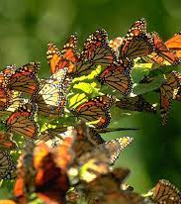
When is their mating season?
In Ontario, monarch butterflies primarily mate during their spring and summer breeding cycles, which generally occur from late May to early June and continue through September. The overwintering butterflies that arrive in Mexico begin their return migration and mating process in late February or March, but these butterflies do not return to Ontario; they lay eggs along the way, and the next generation continues the migration, ultimately reaching Ontario in June.
Do they have only one life-long partner?
No, monarch butterflies do not typically have life-long partners. While mating can last for a day or two, both sexes can mate multiple times throughout their lives. And adult monarchs from the summer generation only live for a few weeks. The last generation of monarchs in the fall, which migrate, also do not reproduce and focus on building fat reserves for their migration.

Slide 25
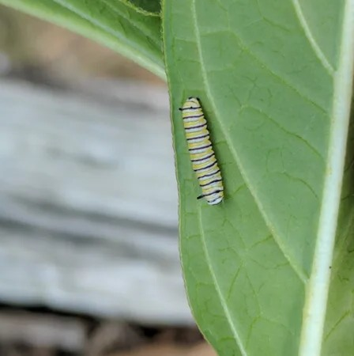
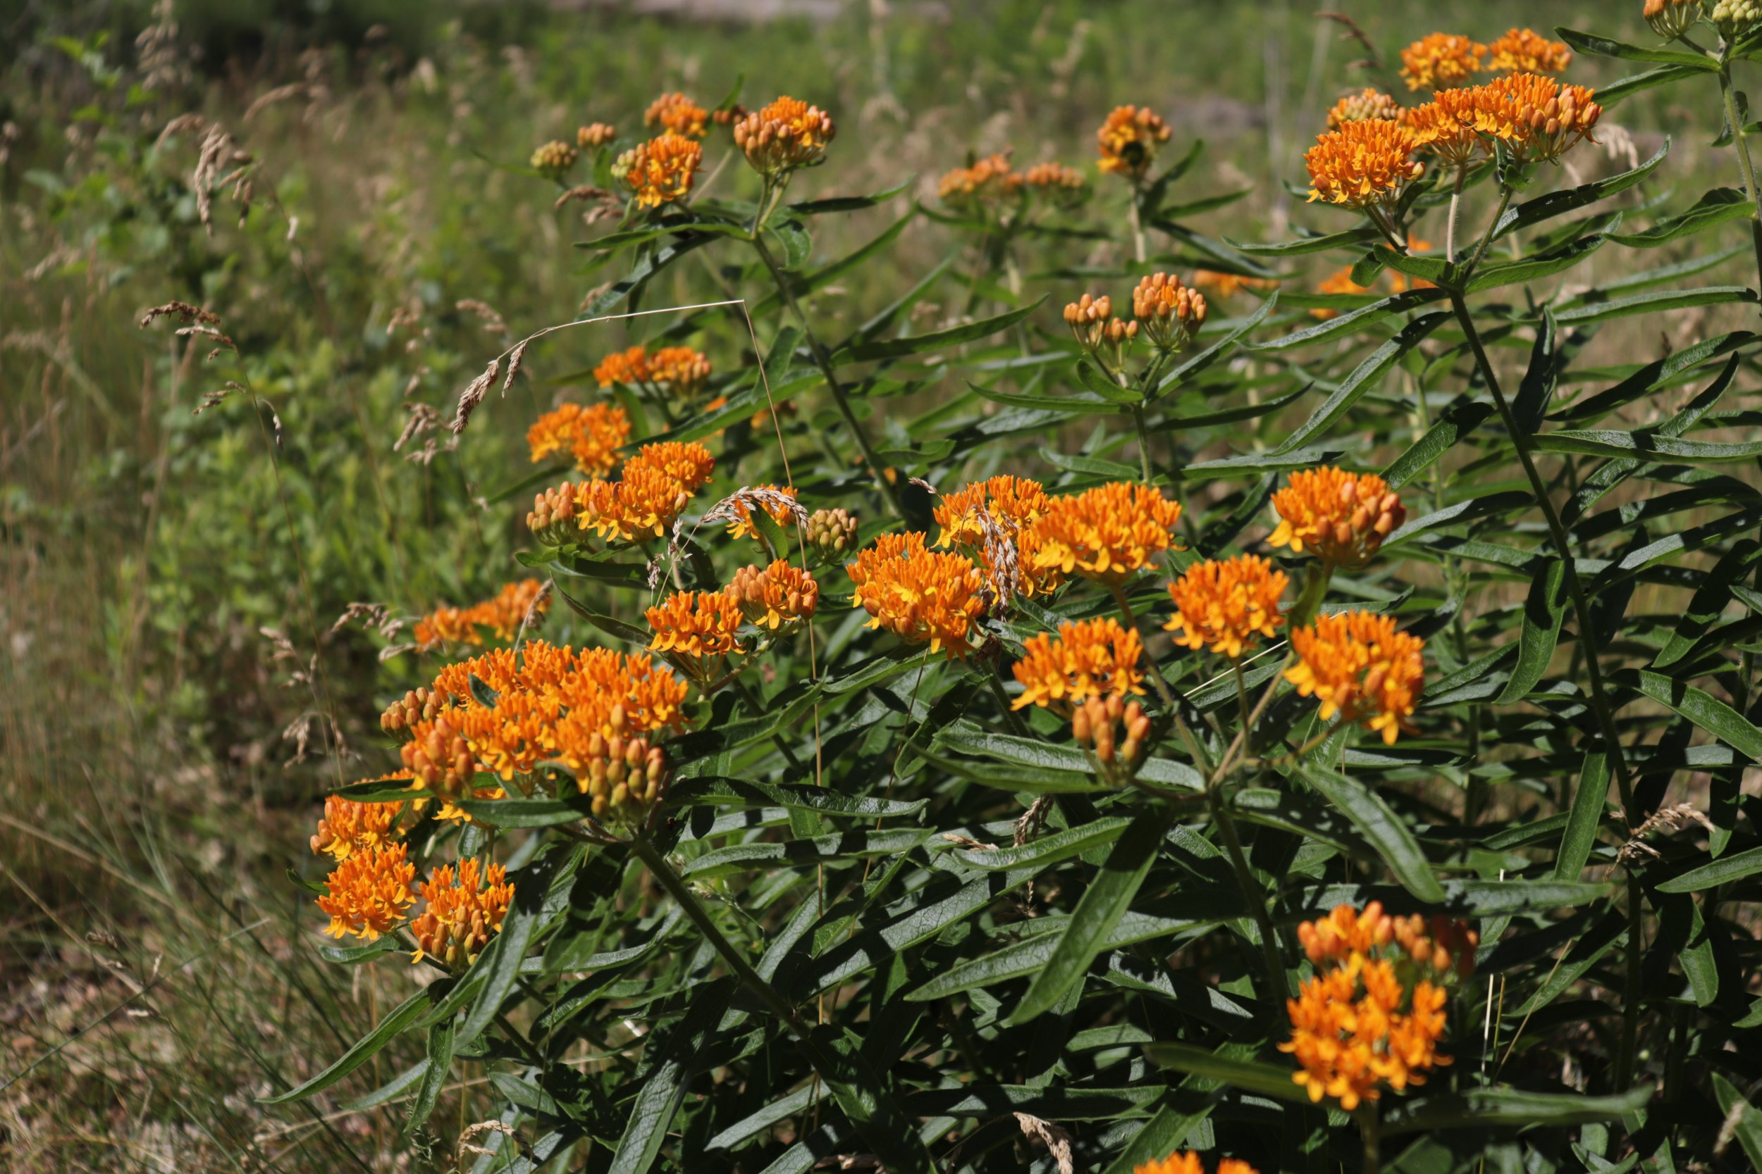
Where do Monarch Butterflies lay their eggs?
In Ontario, monarch butterflies lay their eggs on milkweed plants. These eggs hatch into caterpillars, which then develop into pupae (chrysalises) before emerging as adult butterflies. The butterflies then continue their journey, eventually migrating to central Mexico for the winter.
When and how many eggs are laid?
The females will lay eggs, and it is these offspring that continue the journey north to reproduce in Ontario arriving usually in early June.
Females lay approximately 400 pin sized eggs on the underside of milkweed leaves and will have 2-3 broods in one season.
The eggs hatch 3-12 days later depending upon temperatures.

Slide 26
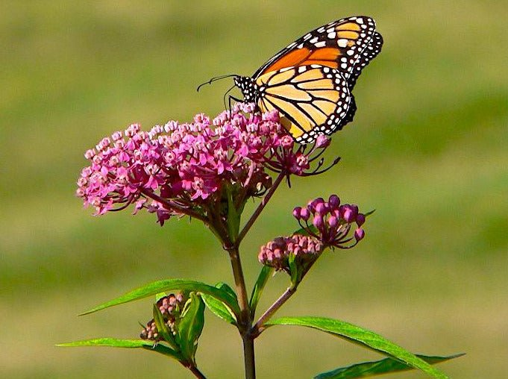
When and where do they hibernate?
During late summer and fall, Monarchs from Ontario migrate to central Mexico where they spend the winter months.
Who are their predators?
Monarch butterfly predators in Ontario include ants, spiders, true bugs, parasitic wasps, some flies, and the birds like the Black-headed Grosbeak and the Black-backed Oriole. Monarch eggs are also prey for various species like ants and spiders.

Slide 27
What are the threats facing this species?
Monarch butterflies in Ontario face several threats to their survival, including habitat loss, pesticide use, climate change and vehicle collisions.
They are even facing habitat loss at their overwintering sites in Mexico because of the widespread use of pesticides, especially neonicotinoids, are now major concerns.
Additionally, extreme weather events and the decline of milkweed, the sole food source for caterpillars, can also negatively impact the monarch’s population.

Slide 28
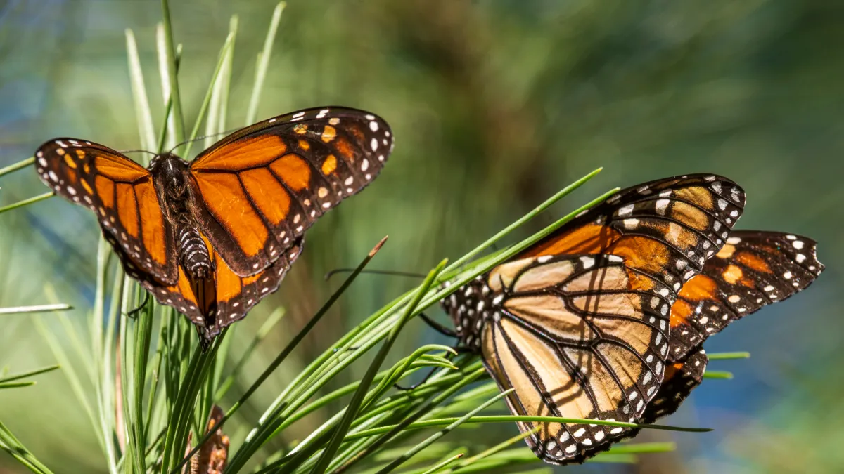
Why are they considered a Species at Risk?
The monarch butterfly is considered a species at risk in Ontario due to a combination of factors, primarily habitat loss and degradation, as well as the use of pesticides and herbicides. Specifically, the decline of milkweed, the monarch's sole food source as caterpillars, has significantly impacted their ability to reproduce and survive.
What can be done to stop this?
To help monarch butterflies in Ontario, we need to focus on providing them with essential habitats like milkweed and native wildflowers for nectar.
One of the easiest ways you can help save the Monarch Butterfly is to plant Milkweed and native wildflowers in your yards and/or gardens. Avoid using pesticides and engage in citizen science projects to monitor monarch populations.

Slide 29
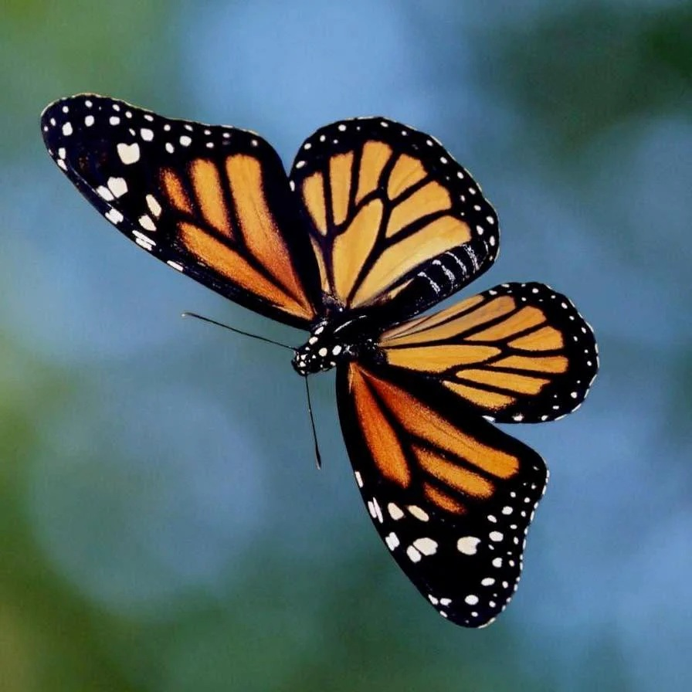
DO YOU HAVE ANY SUGESTIONS ON WHAT THE AGGLFN COMMUNITY CAN DO TO HELP THE MONARCH BUTTERFLY?
PAUSE FOR RESPONSES OR COMMENTS FROM THE COMMUNITY MEMBERS AND RECORD THEM.

Slide 30
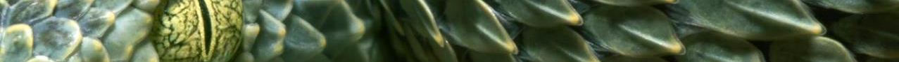
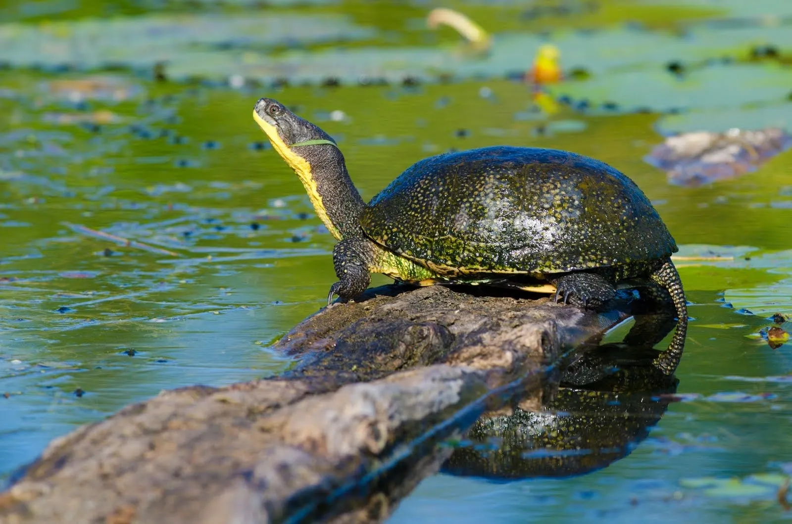
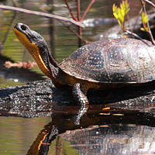
SPECIES AT RISK
BLANDING’S TURTLE

Slide 31
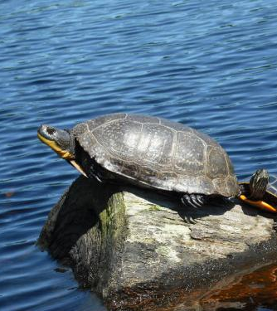
How can you determine this is a Blanding’s Turtle?
Blanding's turtles in Ontario are easily identified by their bright yellow chin and throat, and their domed, smooth upper shell that resembles an army helmet.
The shell is typically black to brown with yellow flecks and streaks. It can range up to 27 centimetres long. Their head and limbs are black-grey, and their lower shell (plastron) is rich yellow.
Quick Facts:
It can take a female Blanding’s Turtle up to 25 years to mature. This long-lived species can survive in the wild for more than 75 years.
Unlike other Ontario turtles, the bottom shell is hinged so that some Blanding’s Turtles can completely close their shell after pulling in their head and feet.

Slide 32
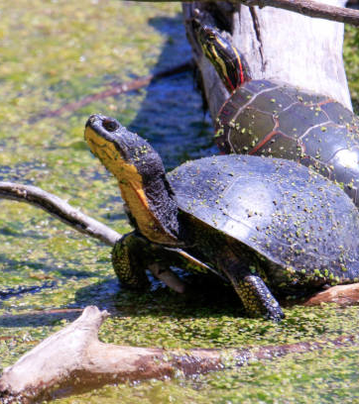
What do the Blanding’s Turtle consume?
Blanding's turtles in Ontario are omnivores, meaning they eat both plants and animals.
Their diet includes a wide variety of items like crayfish, fish, frogs, insects, worms, leeches, snails, and slugs. They also consume aquatic vegetation and some terrestrial plants.

Slide 33
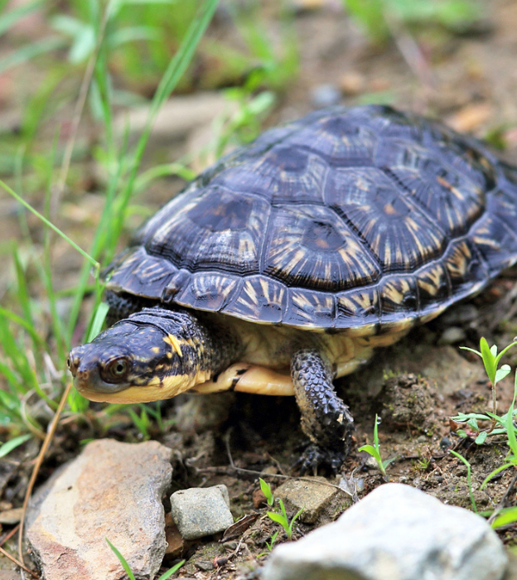
What is the Blanding’s Turtles preferred habitat?
Blanding's turtles inhabit shallow lakes, ponds and wetlands with clean water and mucky bottoms. They have the largest overland movement of any Ontario turtles, travelling up to several kilometres between summer habitat and nesting sites or overwintering habitat.
While they prefer wetland areas like marshes and swamps, they may also be seen in terrestrial habitats while moving between different habitats, according to The Canadian Encyclopedia.
It is not unusual, though, to find them hundreds of metres from the nearest body of water, especially while they are searching for a mate or traveling to a nesting site.

Slide 34
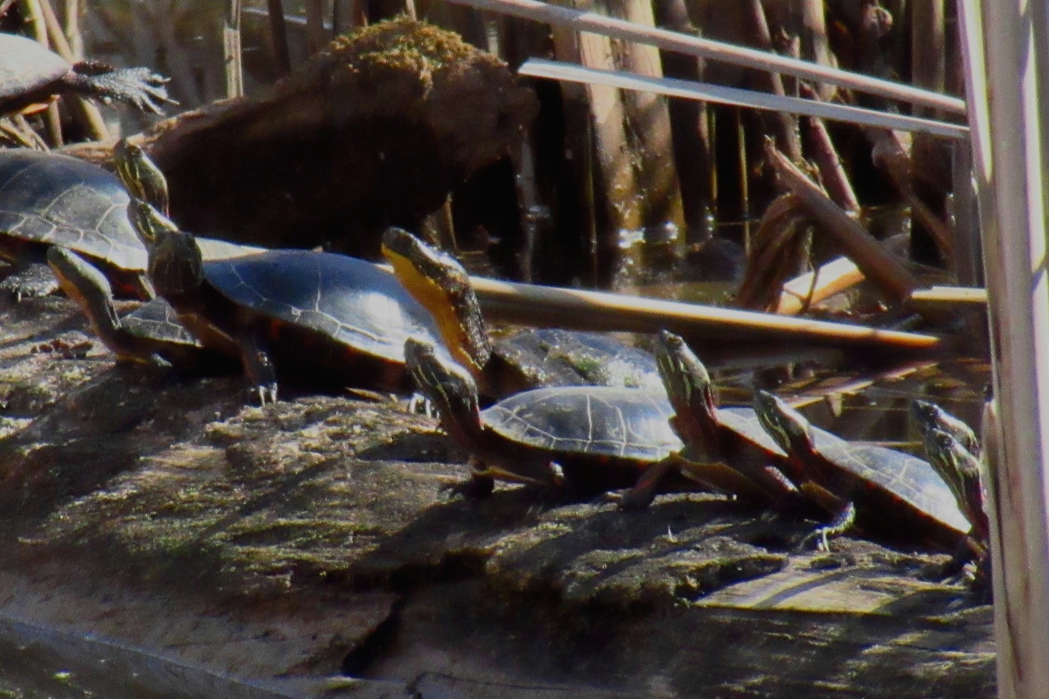
When is their mating season?
Blanding's Turtle mating season in Ontario typically occurs during their active season, which extends from ice-off in the spring (usually April) to late October. While mating can occur anytime during this period, including during hibernation, the most common times for mating are in April, September, and October. Females store sperm and can use it later, allowing for mating even before or after the main nesting period.
Do they have only one life-long partner?
No, Blanding's turtles in Ontario do not typically have life-long mates. While they are known for their courtship rituals, which can be quite elaborate, Blanding's turtles are generally considered promiscuous, with multiple males often fertilizing the eggs of a single female.
Courtship:
Male Blanding's turtles do engage in courtship behaviors, including caressing a female's head and nibbling her neck, which can last for over an hour.
Promiscuity:
Despite these courtship displays, Blanding's turtles are not known for forming lasting pair bonds. Multiple males can and often do mate with the same female, resulting in eggs fertilized by different fathers.
Long Lifespan:
Blanding's turtles can live for a very long time, up to 75 years or even longer in the wild, according to the Ontario government website. While they may have multiple breeding partners throughout their lives, they do not typically form long-term, exclusive relationships.

Slide 35
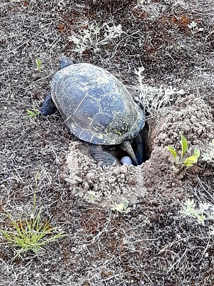
Where do they lay their eggs?
Nest Location:
Blanding's turtles prefer to nest close to water sources, but they may travel considerable distances to reach a suitable site, sometimes up to 6 kilometers.
Nest Characteristics:
They often excavate these nests in sunny areas with good drainage.
Habitat:
Blanding's turtles are primarily aquatic and spend a significant portion of their time in wetlands like marshes, swamps, and ponds.
Movement Corridors:
The area within 250 meters of wetlands is considered a critical movement corridor for hatchlings to access the water.

Slide 36
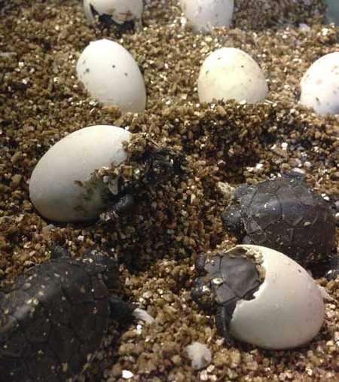
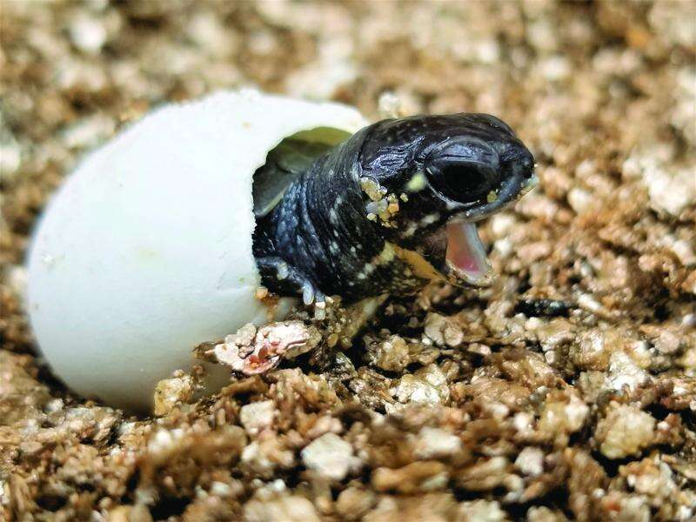
When are the hatchlings born?
Blanding's Turtle Hatchlings emerge from the nests between August and September and can emerge as early as mid-August in warm years, or later in the fall in cooler years.
The incubation period varies depending on the weather, but it generally takes 60 to 90 days.
Nesting, where the female lays her eggs, usually occurs between late May and early July. Females lay 3-25 elliptical eggs in a single clutch.
Do they hibernate?
Yes, Blanding’s Turtles hibernate in the mud at the bottom of permanent bodies of water from late October until the end of April.

Slide 37
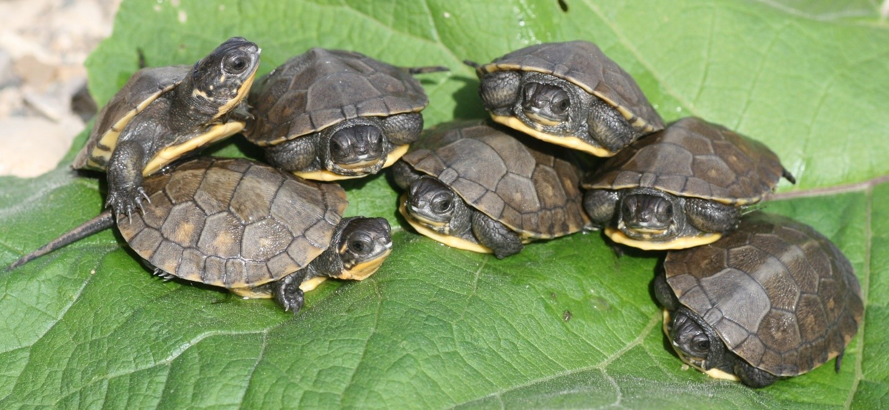
Who are their predators?
In Ontario, Blanding's turtles primarily face threats from predators like raccoons, skunks fish, snakes, foxes and wading birds that prey on their nests and eggs.
While adult turtles are less vulnerable due to their strong shells. hatchlings and small juveniles are very susceptible to predation from various animals.

Slide 38
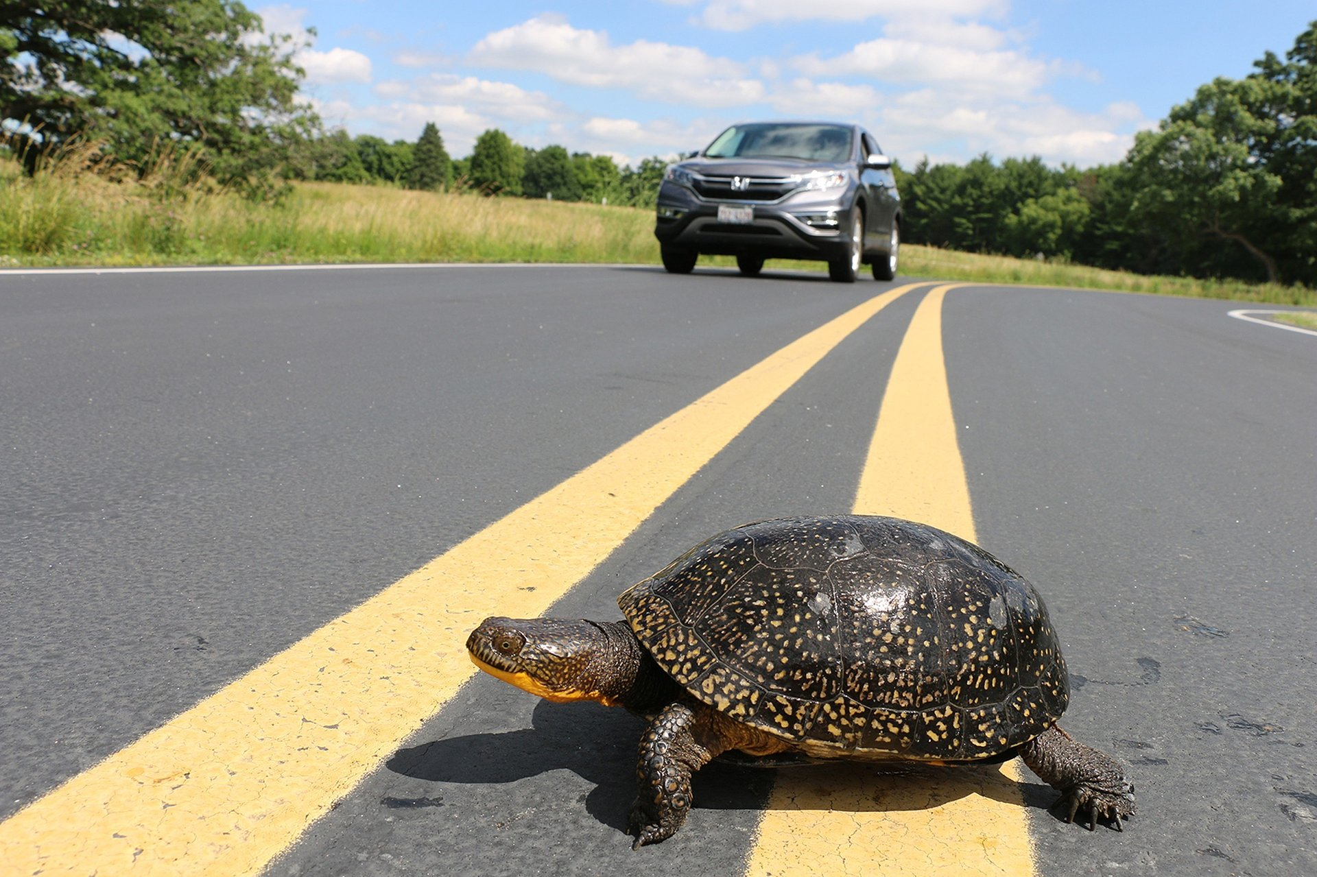
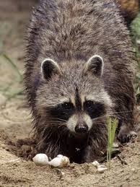
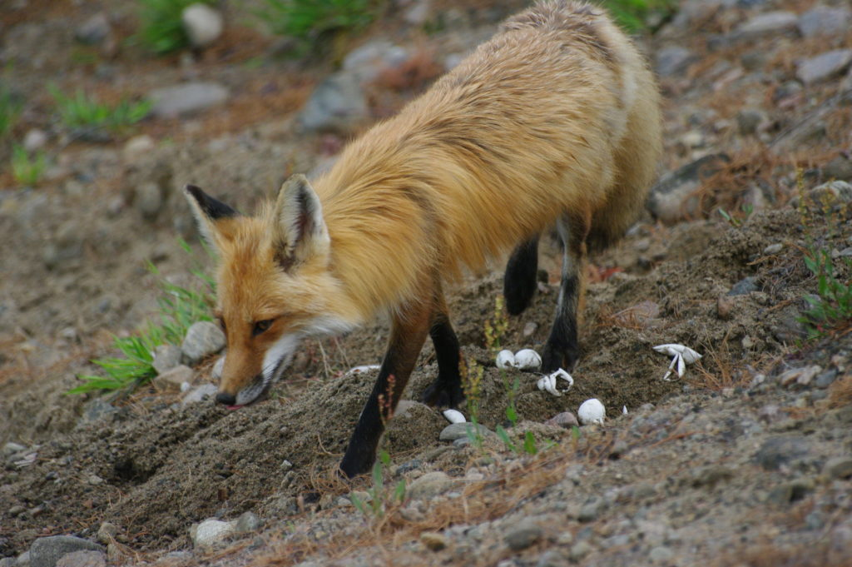
What other threats does this species face?
Habitat Loss:
The destruction or fragmentation of wetlands and other habitats is a major threat to Blanding's turtle populations.
Road Deaths:
Turtles crossing roads can be hit by vehicles, leading to injury or death.
Human-Subsidized Predators:
Increased numbers of predators like raccoons, foxes and skunks, due to human activity and available food sources, can lead to higher levels of nest predation.

Slide 39
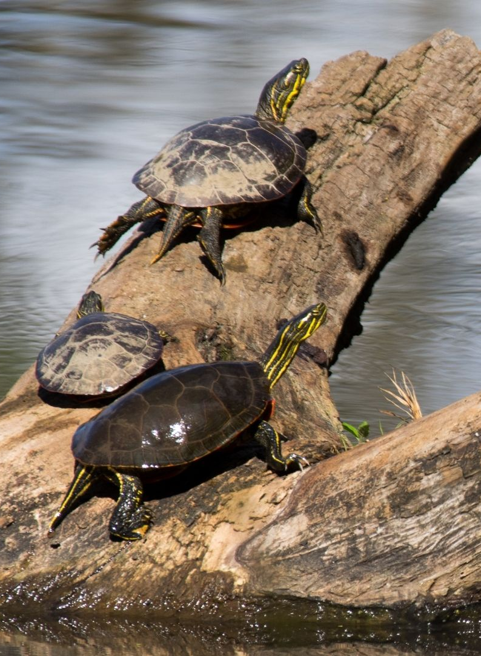
Why are they now a Species at Risk?
Habitat Loss and Fragmentation:
Wetlands, crucial for Blanding's Turtle survival, are being converted for residential and commercial development, leading to a decline in habitat. This fragmentation isolates populations, making it harder for them to find mates and resources.
Road Mortality:
As Blanding's Turtles cross many roads to reach nesting sites, they are vulnerable to being hit by vehicles. Roadways also disrupt their natural migration patterns.
Egg Predation:
Raccoons, foxes, and other predators consume Blanding's Turtle eggs, particularly those laid near roads or in areas with increased predator populations.
Illegal Collection:
Blanding's Turtles are sometimes collected for the pet trade or for their eggs, further impacting populations, according to the Ontario Turtle Conservation Centre and Ontario Nature.
Delayed Maturity and Slow Breeding:
Blanding's Turtles mature late and have a long lifespan, meaning it takes a considerable time for them to reach breeding age, and the death of even a few breeding-age adults can have a significant impact on the population.

Slide 40
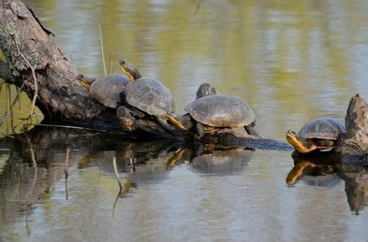
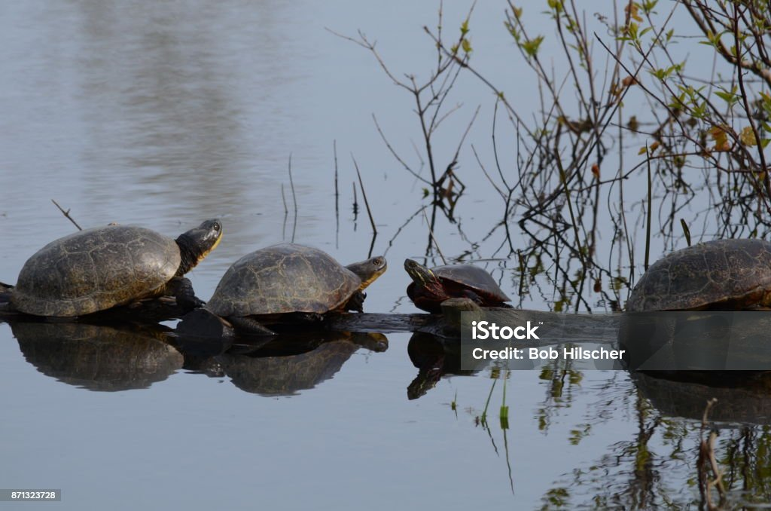
What can be done to protect them and stop this?
The Blanding's turtle is currently listed as Threatened under the Ontario Endangered Species Act, 2007 and Endangered under the Federal Species at Risk Act.
You can help by protecting any wetlands and surrounding natural vegetation either on your property or on Crown Land.
STAY AWAY. Do not go within 250 M of a Blanding’s Turtle’s nesting area. The only reason why you could be in this area, is if you are putting fencing around the turtle nest to protect it from natural predators and human intervention.
Every year, turtles all over the province must cross busy roads to get to their nesting sites.
Female Blanding's Turtles sometimes mistake gravel shoulders of roads as good nesting sites.
While driving, you should watch for turtles on the roads or on gravel shoulders of the road especially between May and October. If you see a Blanding’s Turtle near or on the road, you should stop your vehicle and safely help it cross the road in the direction it was heading.

Slide 41

Report any sightings of Blanding's turtles, whether they are healthy or injured.
Report any instances of illegal collection, such as turtles being sold in pet stores or food markets.
Use the Report pollution online form or call the public reporting hotline (1-866-MOE-TIPS) to report these concerns.
Submit your observations to the Ontario Reptile and Amphibian Atlas.
416-444-8419, toll-free (within Ontario): 1-800-440-2366 info@ontarionature.org Hours: Monday-Friday, 9 a.m.–5 p.m.

Slide 42

DO YOU HAVE ANY SUGESTIONS ON WHAT THE AGGLFN COMMUNITY CAN DO TO HELP THE BLANDING’S TURTLE?
PAUSE FOR RESPONSES OR COMMENTS FROM THE COMMUNITY MEMBERS AND RECORD THEM.

Slide 43

BLANDING’S TURTLE RECOVERY STRATEGY
At the Sand Lake Site, the AGGLFN have produced a Species at Risk plan to try to help save the Blanding’s Turtle.
Starting in mid-May this site which is located on Crown Land is well known to be occupied by 20-30 camper trailers and all-terrain vehicles for the whole summer. And we noticed that some camper trailers are already parked there and are semi-permanent.
So, we have asked two monitors to start the first week of May. They will go up to monitor this area on a weekly basis to see if the Blanding’s Turtle are still in this area. Depending on the weather monitoring and reporting will take place from beginning of May until the beginning of September roughly.
And to keep the camper trailers and foot traffic out of this area for the nesting period, we are planning on putting up silt fencing 250 M away from the waterfront to barricade this area off. This will allow the Blanding’s Turtles to come up to their build nests and lay their eggs. The fencing will be removed in September.
If nests are built the monitors will then put special fencing around each nest to protect them from natural predators and human intervention. This area will be filled with tons of signage on what we are trying to do to protect the Blanding’s Turtle.
The campers will have to move back and still have access to the lake via the alternate entrance located to the right side of the area we are intending to close-off to the public.
A silt fence is a temporary sediment barrier made of porous fabric. It's held up by wooden pickets driven into the ground, so it's inexpensive and relatively easy to remove.

